Slide 1
How to insert a media file into your webpage

Slide 2
Find an audio file online, your own MP3, or create your own
Download an audio file from a reliable source
It MUST be saved file as an MP3 file to allow for easy upload to your page.
Your audio file NEEDS to be saved in the same place that you are saving your webpages
Into W:drive and saved in the sports/music folder
Always double check that your saved audio file works before uploading it to your webpage

Slide 3
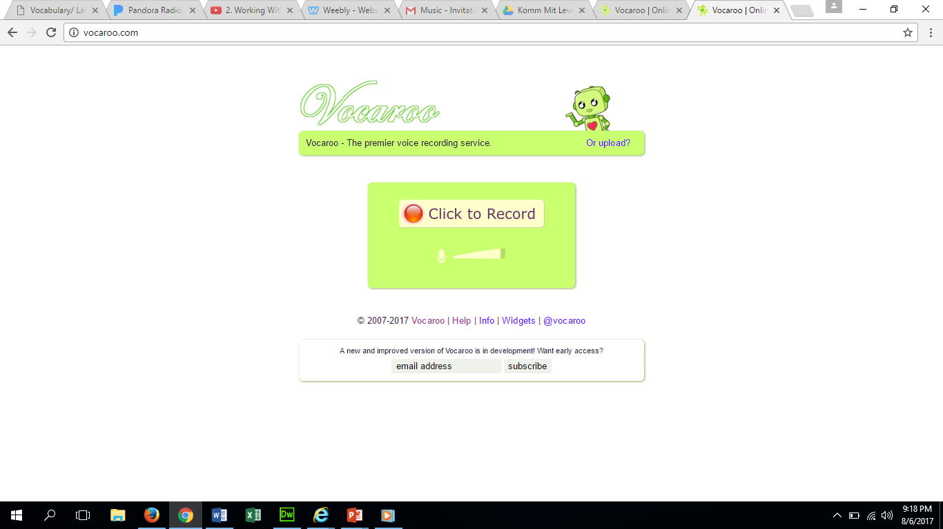
Vocaroo is a free and useful voice recorder if you are having a hard time finding an MP3
You may need to do this at home, because of background noise.
You can play the video, or radio news cast that you want to use and record it.
Be sure to listen to it, to make sure it is the quality you want. If it sounds like an echo then turn down your volume on the computer and re-record.

Slide 4
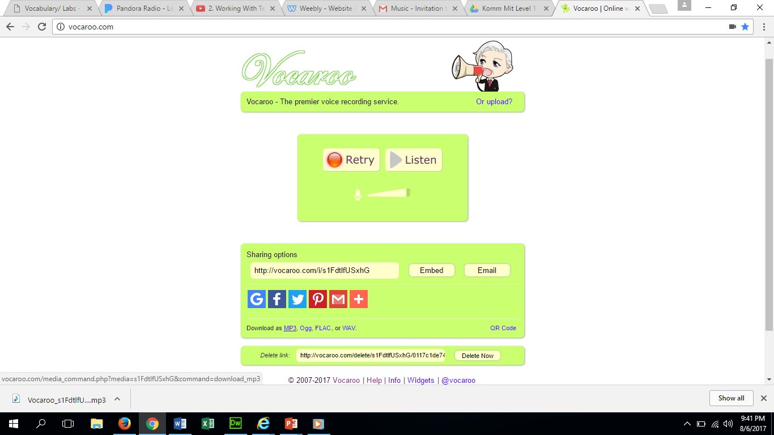
After recording:
Click on download as MP3 located right below the Google and Facebook Icons.
If you see this download bar, then that means that it has been downloaded and is located in your downloads file.

Slide 5
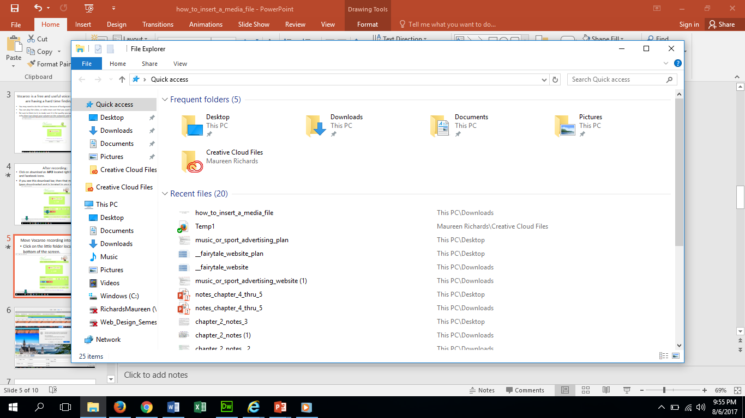
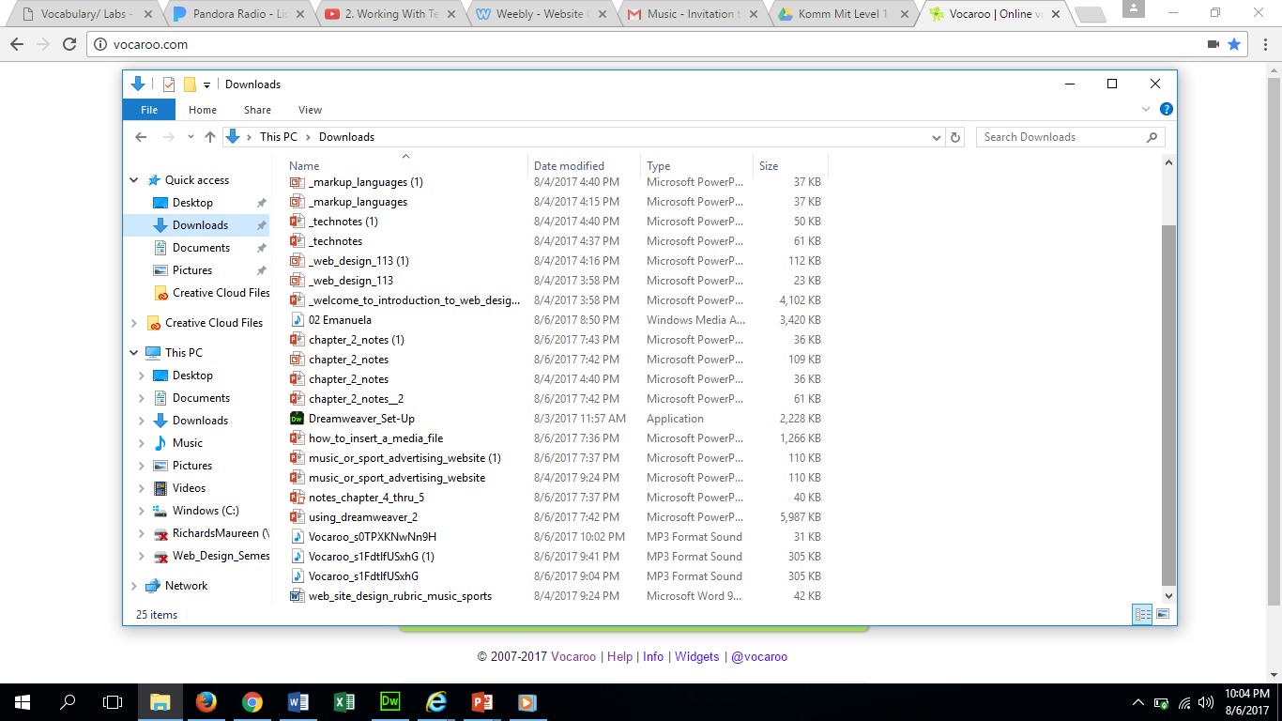
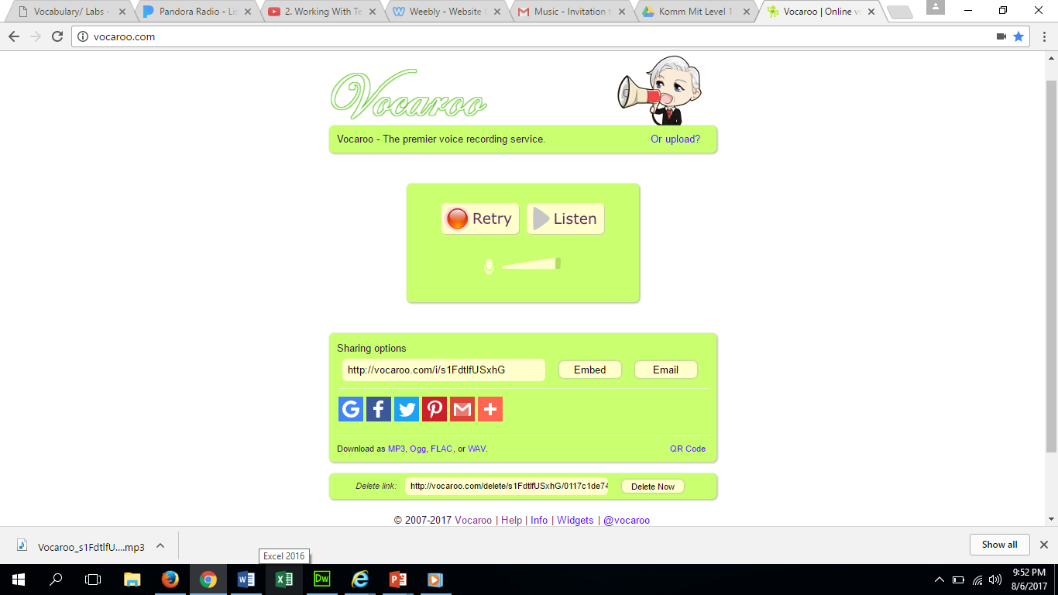
Move Vocaroo recording into your folder
Click on the little folder located at the bottom of the screen.
Find your file and move it into the W:drive.
Then open the W:drive and move your file into the folder.
Click Downloads

Slide 6
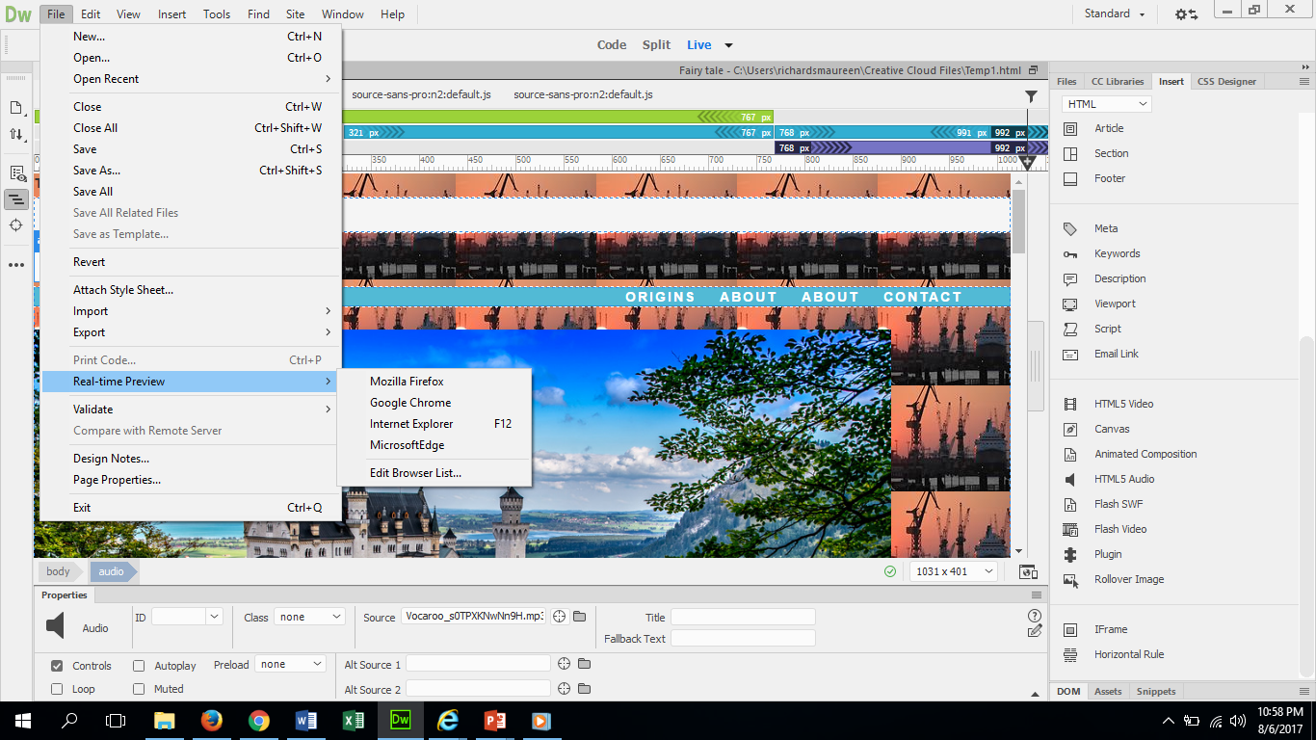
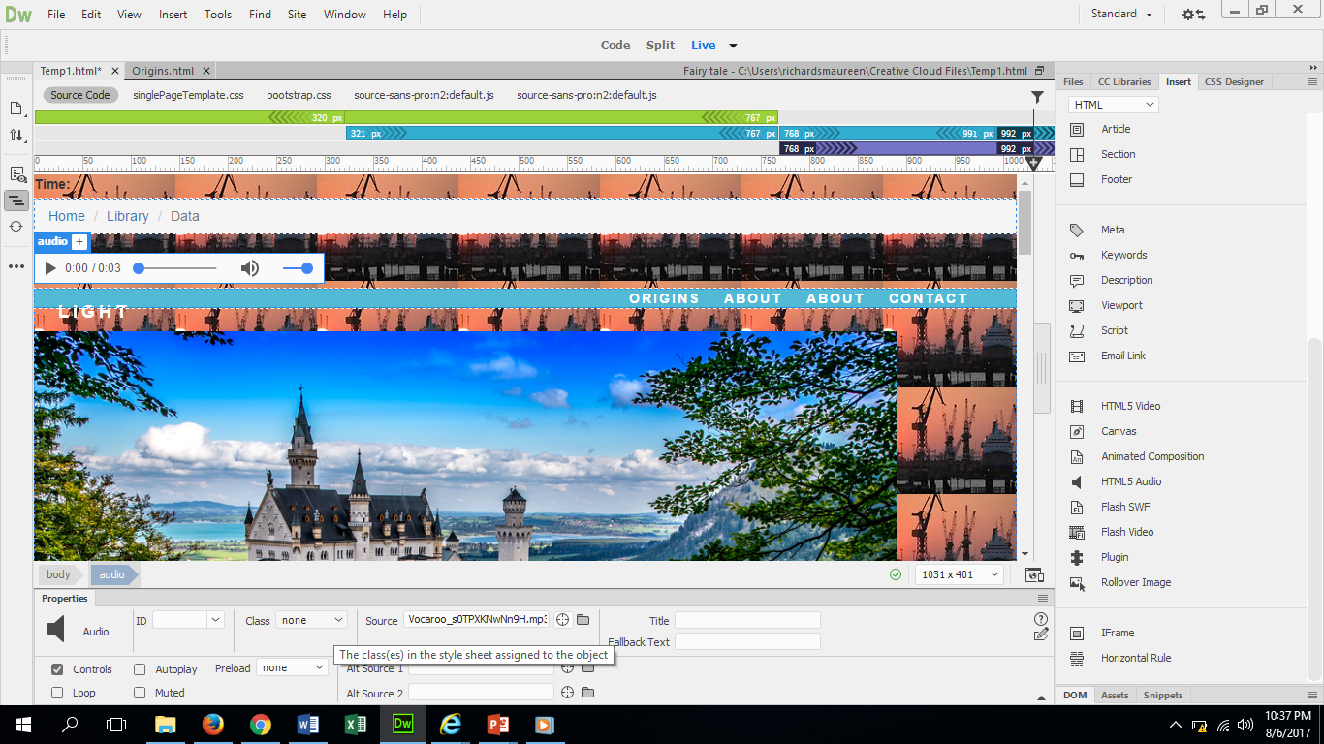
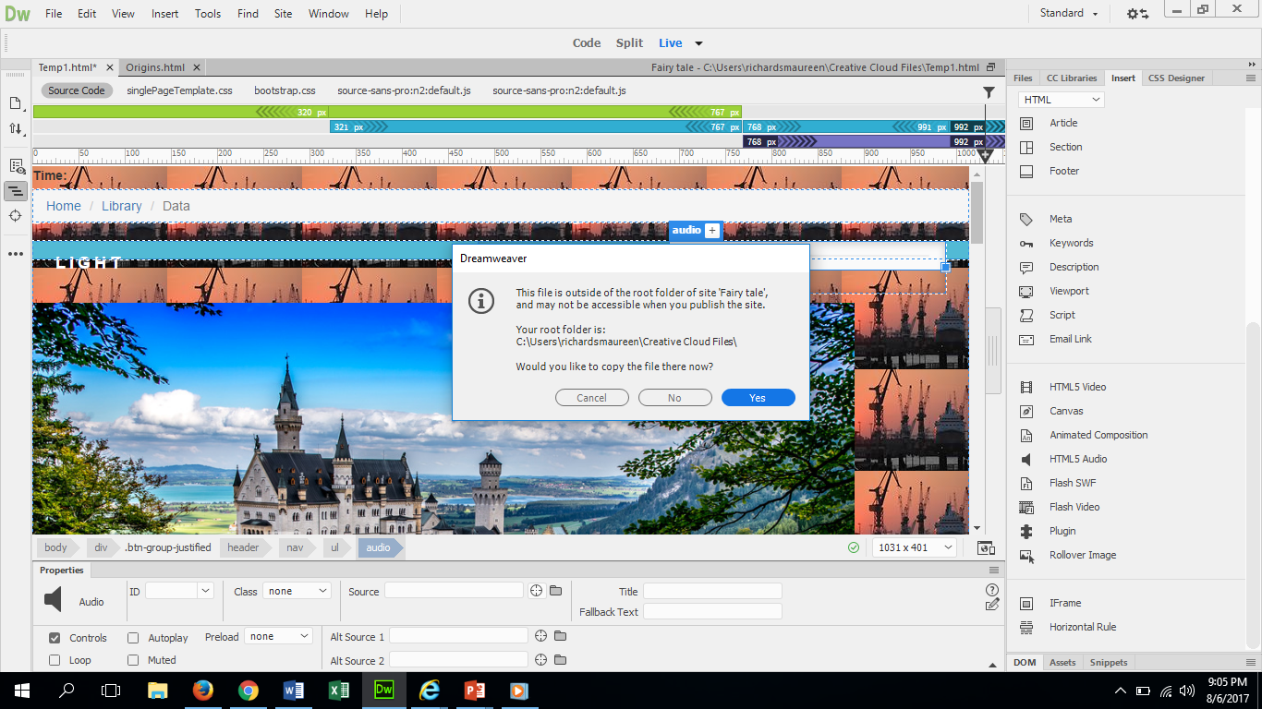
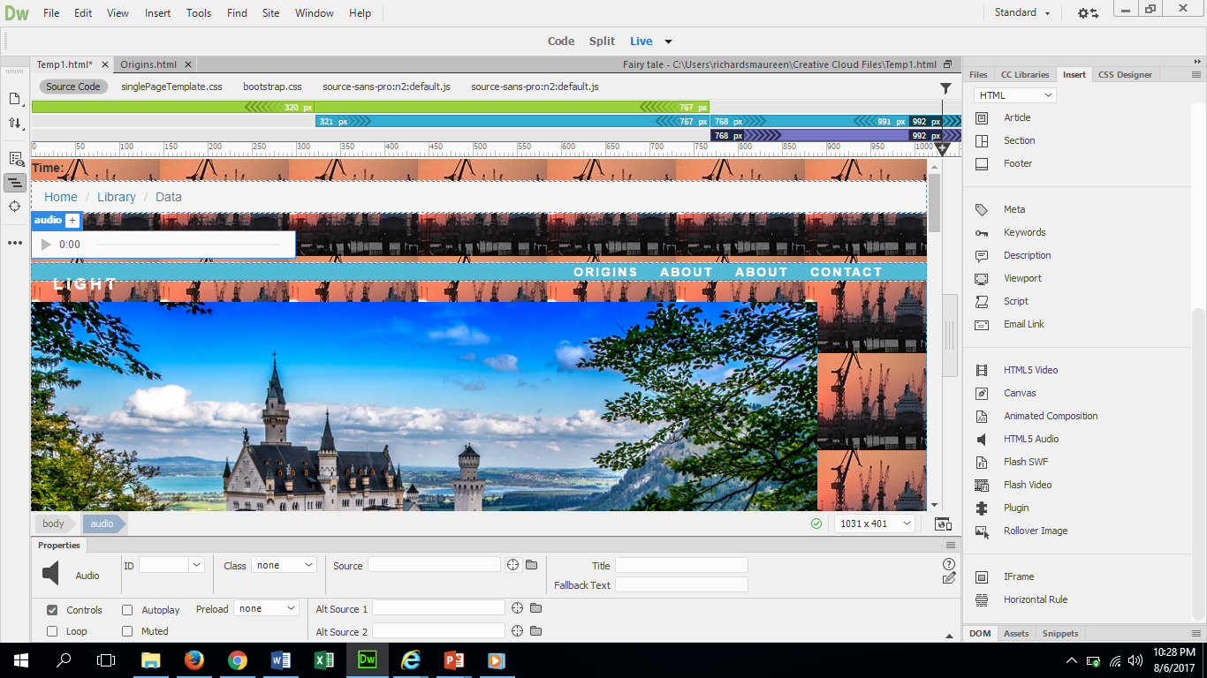
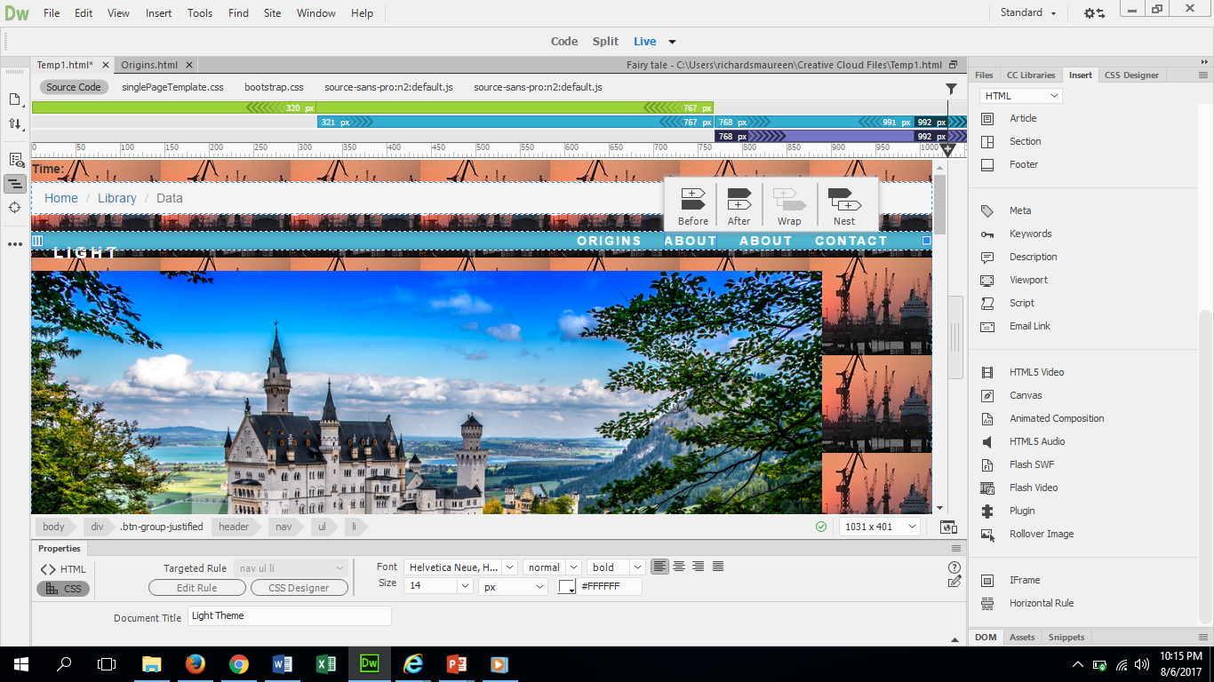
Inserting file
Be sure to put your cursor on the web page where you want the audio file.
Then make sure the insert panel is open and select HTML 5 Audio
Then select whether you want it before or after the element in your website.
Click the little file at where it says source.
Preview in bowser and save!
If you hadn’t saved the file in the right place, select YES
Fill in the title with what the audio file is called. Select if you want it to auto play or to play in a loop
Select the audio file and click OK.

