Slide 1
Use of Photo Shop

Slide 2
Selecting images
Search online for desired photos
Be conscious of color schemes and topic choices
Be sure to click on the photo to go to the actual website that houses the photo
Never just save the thumbnail of photo, because the quality of photo will not be as good and will make it hard to do editing to it
Be sure to save the bibliography information for later work cited
Save as a JPEG file to make it easy for editing and uploading to websites

Slide 3
Inserting Pictures into Photo Shop
Go to file and open
Open all files needed to
create your picture
Your background should
be just that, a background

Slide 4
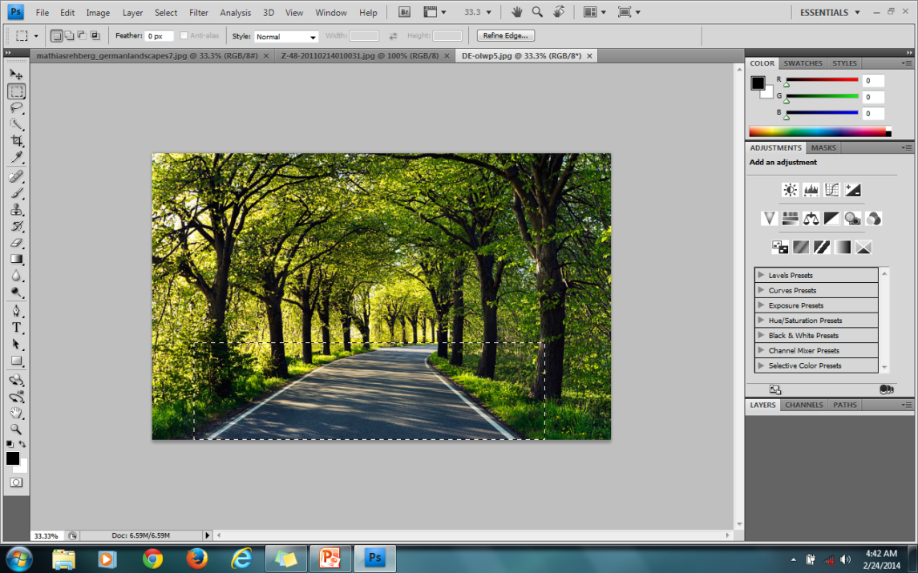
Copying and Pasting
Using your marquise tool (square or circle), encase the part of the image you want to use
Located on the left hand side with dash marks
Get it as close to the image as you possibly can. This allows for less
cropping later
Copy by using ctrl+c

Slide 5
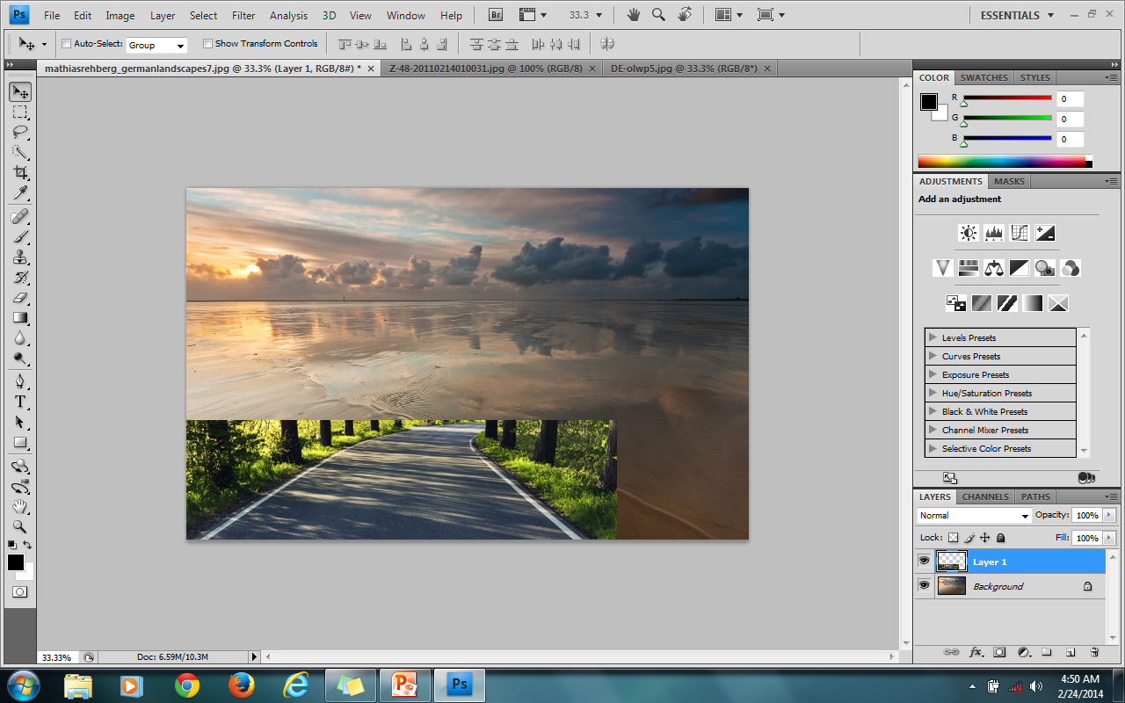
Paste the image you just selected onto another picture (ctrl+v)
Using the arrow with the cross button on the top left tool bar, allows you to move the picture where you want it
You now have 2 layers
You can see how
many layers you are
working with by the
toolbar located on the
right side of screen. By Clicking on a layer it allows
you to work on that layer, or to delete it.

Slide 6
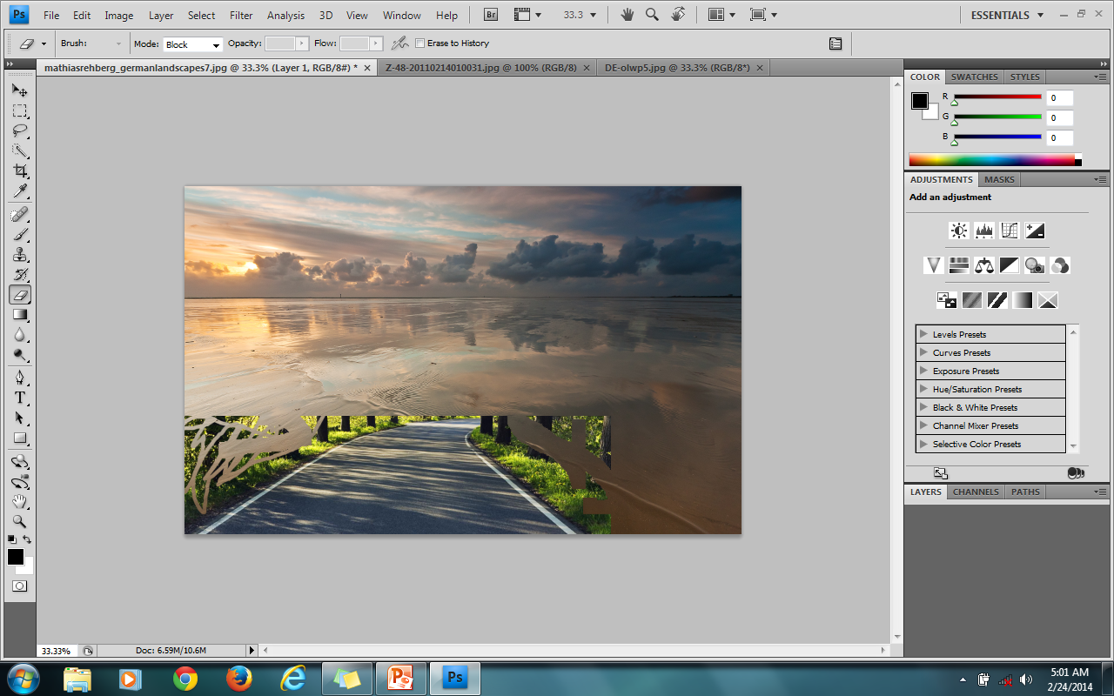
Editing Picture
Getting rid of background from previous picture.
ERASE TOOL
This is good if you need to be exact and there are little parts to your picture that you want to be careful not to erase
Problem: It takes longer to edit with this tool and you must have a steady hand.
This is located on the left toolbar and looks like an eraser
Select it and start erasing
You can change size by toolbar at top of page

Slide 7
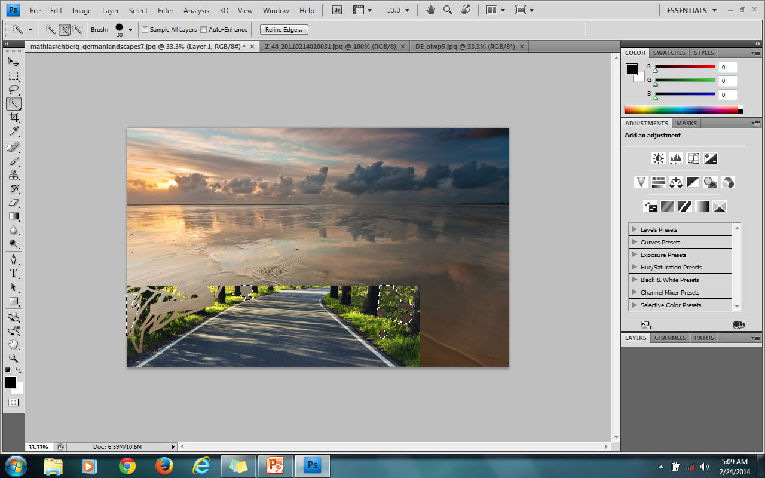
Quick Selection Tool
On the left hand toolbar, select the wand with the dotted lined box
This is quicker at getting rid of excess backgrounds
Sometimes the tool selects more than you want it to.
Click on selection you want deleted and it should appear with a dotted line around it
Press back space to
get rid of that part
of the image

Slide 8
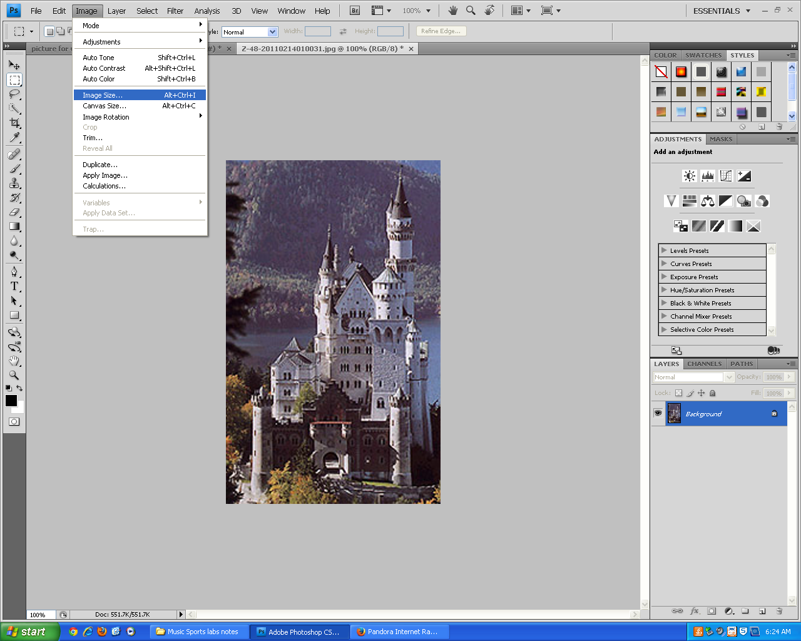
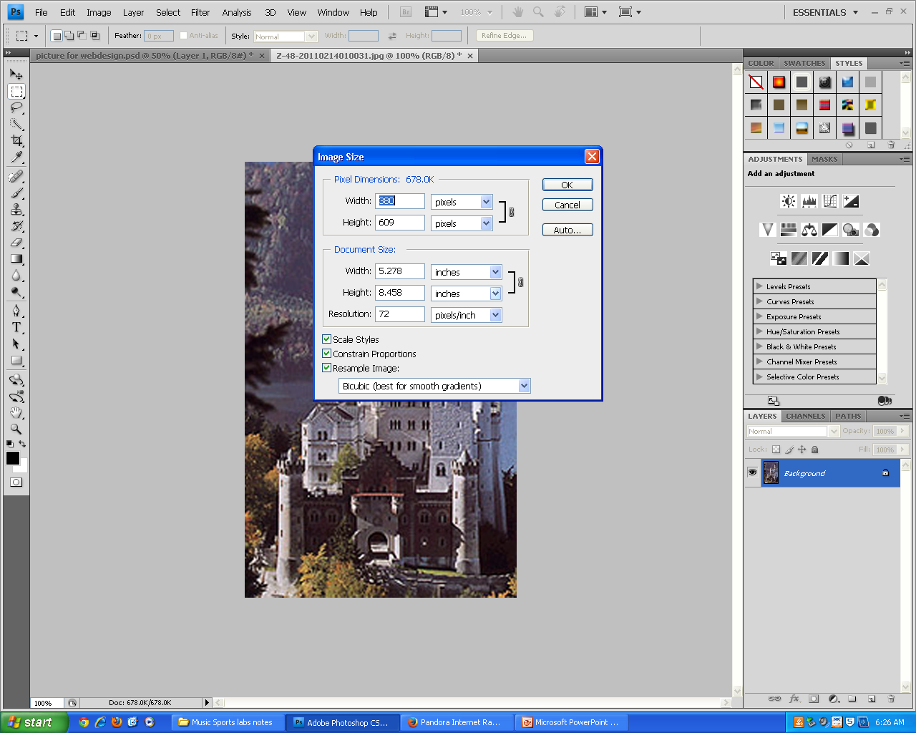
Resizing image
Crop image to what you are focusing on
Leave a little extra on the picture for copying later
Go to images and click image size
In the new box, change the pixel sizes to create a different size.
Be aware that this can change the quality of your photo and if you make it too big could cause the picture to load slower in browser.
Then copy and paste picture like before

Slide 9
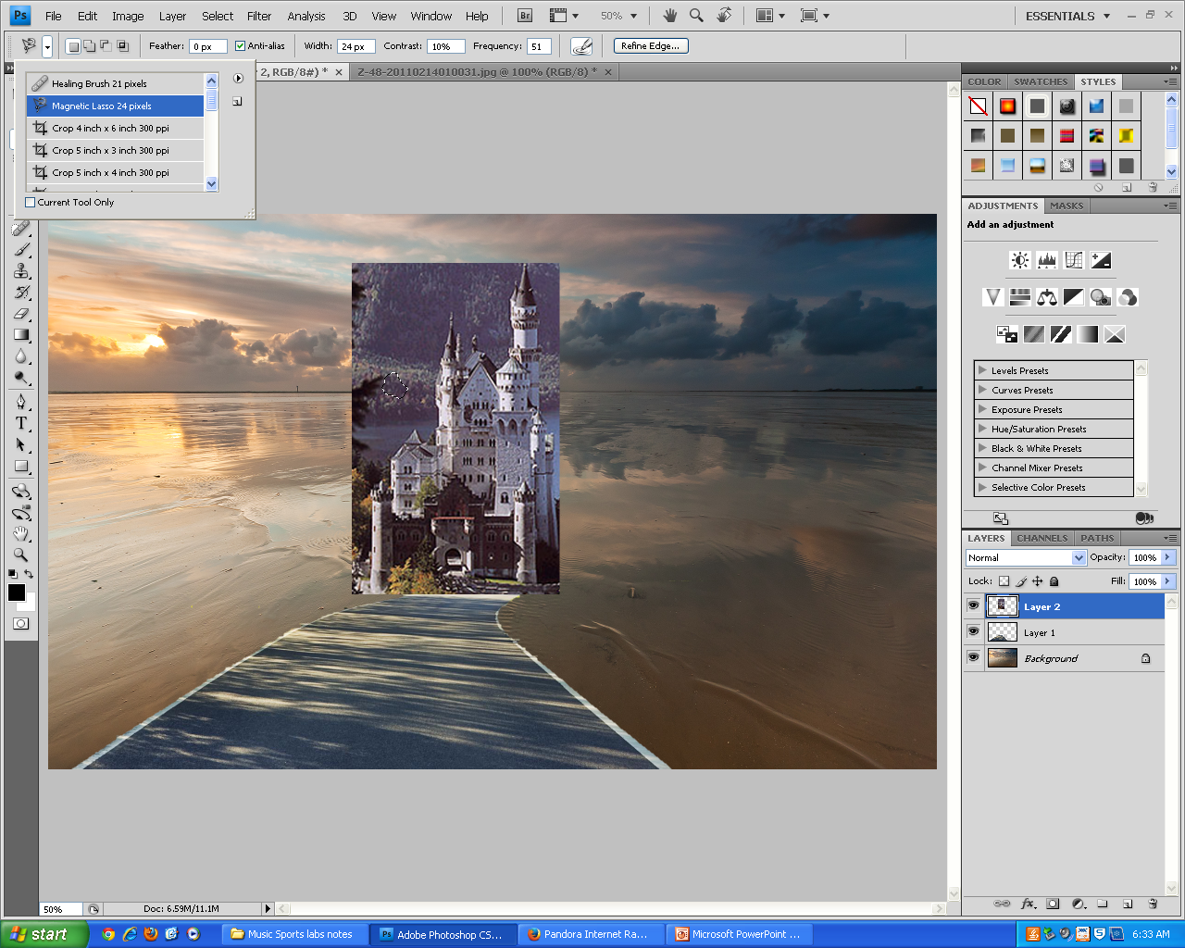
Magnetic Lasso
This is another way to cut out just the picture you want. This allows you to draw around the picture using points to do so.
Be careful to stick close to your picture edge. This tool is slightly instable.
To select tool: click quick selection tool, then go to the top left corner. Click the down arrow and uncheck current tool only. Then select Magnetic Lasso.
Outline the picture that you want, then copy and past on your background

Slide 10
Text Box
Select the ‘T’ tool on the left side
Then draw a text box
You can change the size, font and color

Slide 11
Today’s Lab: Photo Creation
Purpose: To create 2 one of a kind photos using the different tools found in Photoshop
Must include:
3 different photo layers,
Text (at least 1 sentence)
creativity
Website ready
have a work cited
Once photo is completed: Insert your work of art onto a Word document with a work Cited

Slide 12
