Slide 1
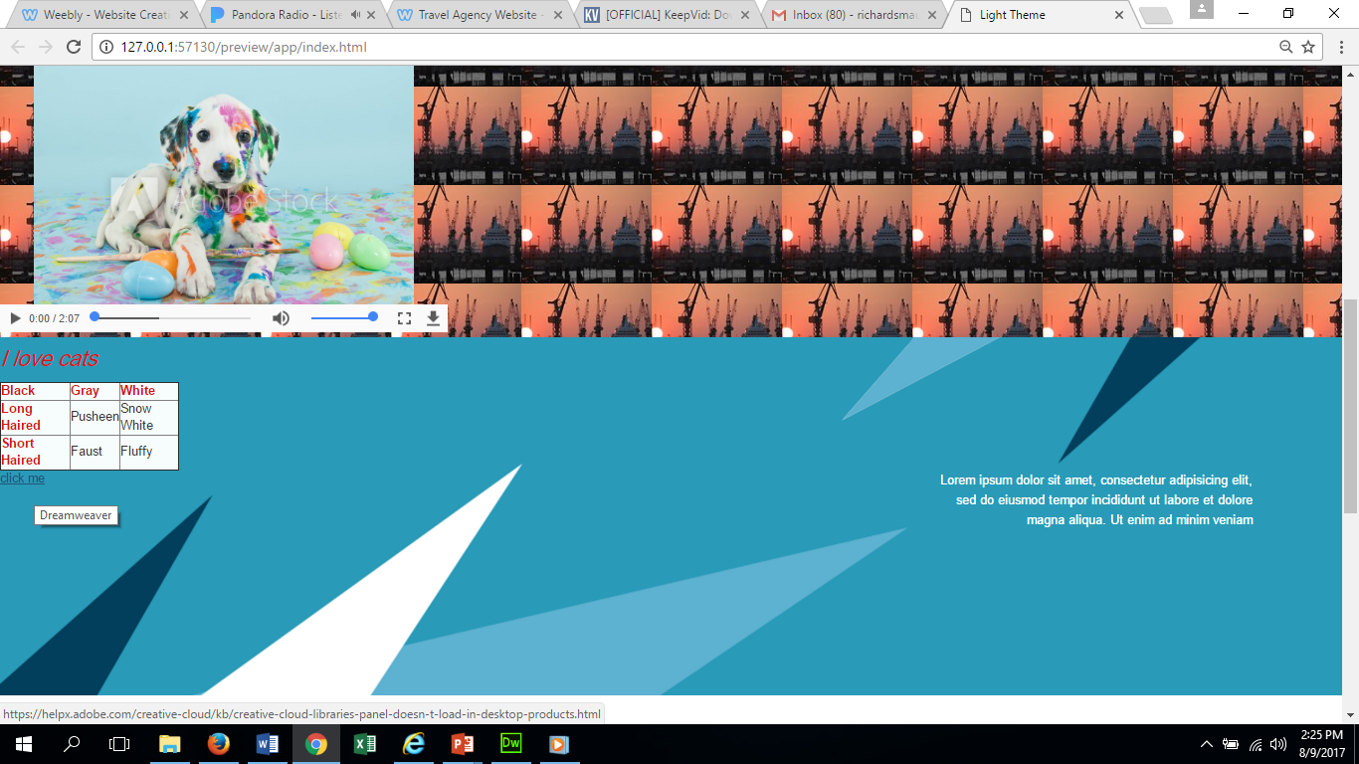
To insert a hyperlink ( a web page address, URL) using text
Click insert and then Hyperlink. Be sure to have the cursor where you want it to go. Do not put it over a blue background, like I did, because the link will be blue. A text box will open.
Fill in the text you want to link, insert the URL (web address). In the target select BLANK ( It allows it to open in a different page.
Title the link and click ok. Put it into preview and click your link to make sure that it is going where it said it was going.

