Slide 1
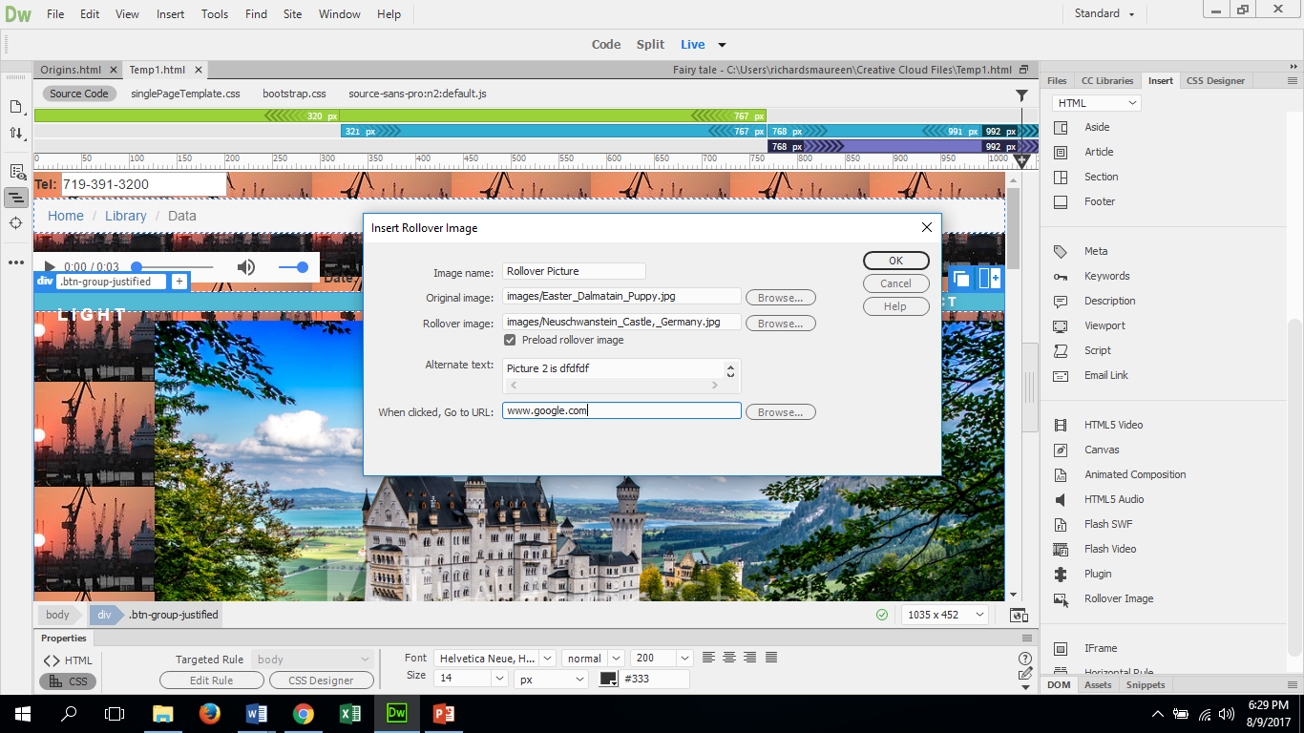
How to insert a rollover image
Rollover images allows for two pictures to be there and when you put your cursor over the image and it will change the image.
Click on insert then choose Rollover image. A dialog box will open up.
Fill in the Image Name and Alternate text.
Click browse and find the two images. The images should be located in the W:Drive.

