Slide 1
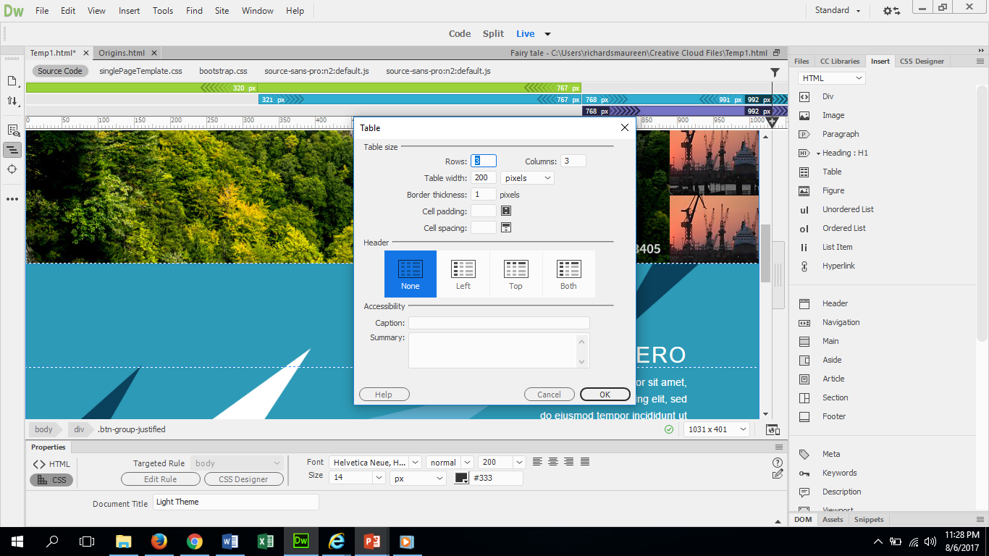
Inserting a table
Place your cursor where you want the table
Select insert and select table. A dialog box will open asking you to decide the specifics of your table.
-Key pointers: Get rid of table width if you want it to automatically size to your content.
-Get rid of boarder thickness if you do not want a boarder
-In caption this is where the header for the entire table goes.

Slide 2
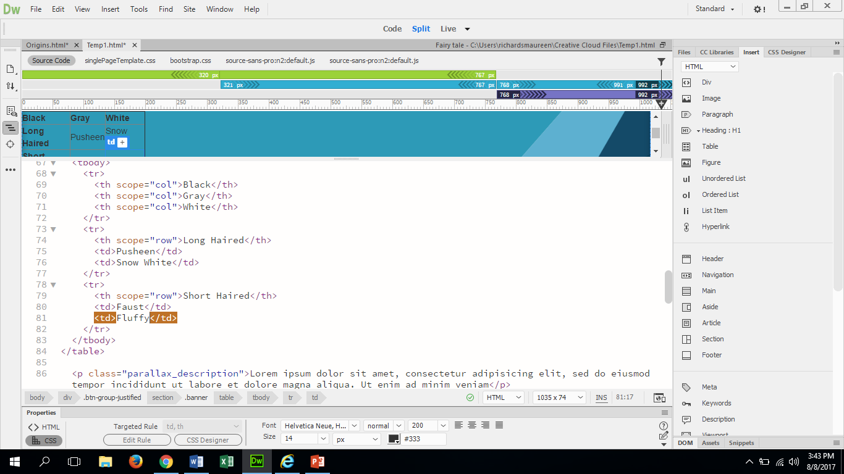
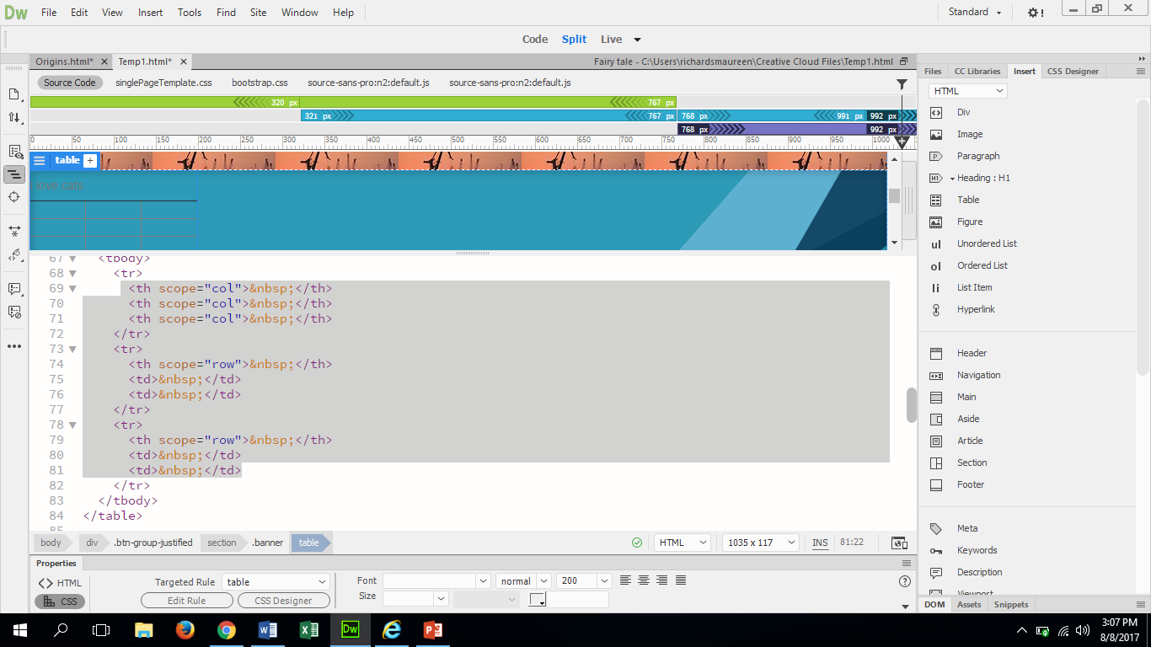
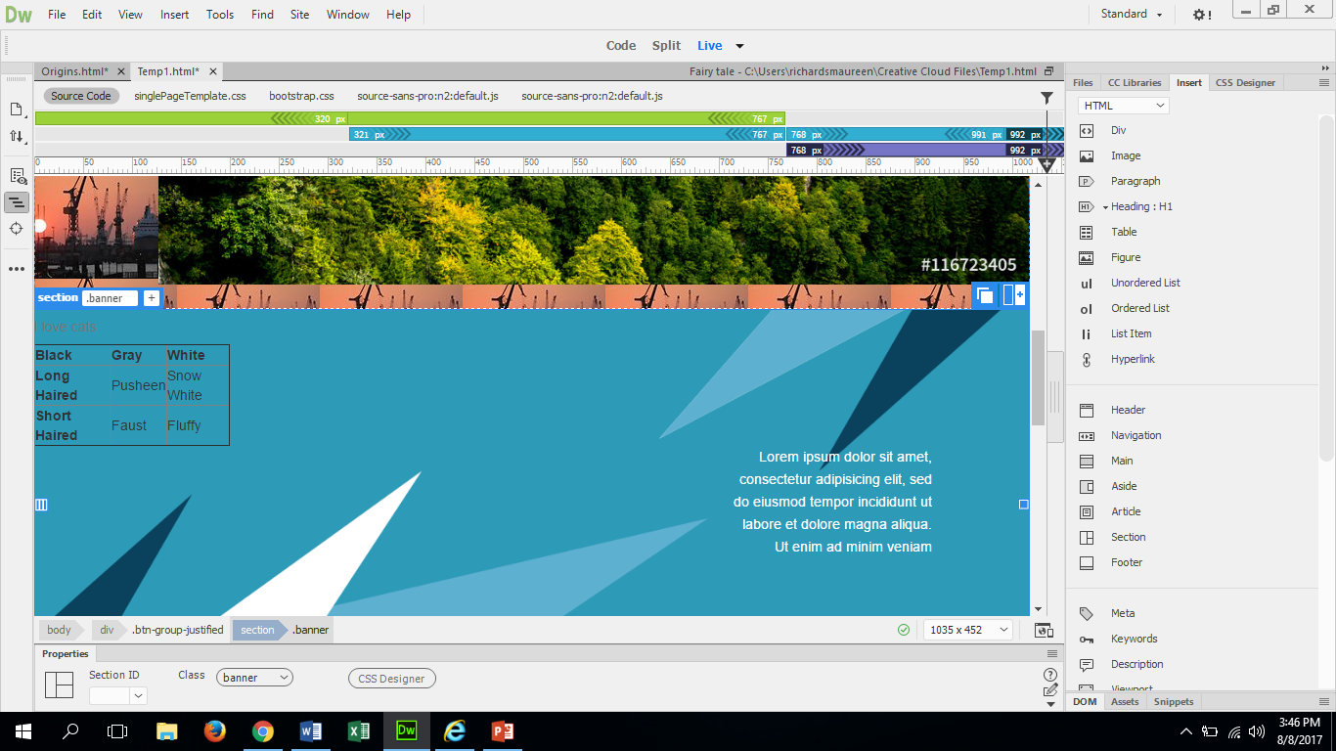
You need to go to split mode and locate where the individual cells are in the coding. ( I have highlighted them for you to find yours)
Look where I changed the coding and how it changed the table above.
<th is the header in the table
<td Is the cell for information.
The part you want to edit is the &nbsp in every line.
So now that we have the words in the boxes, let”s stylize them!

Slide 3
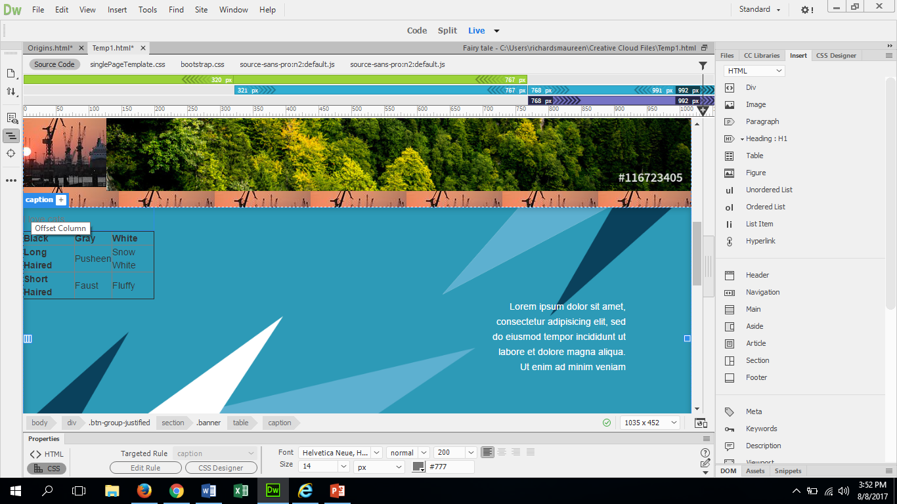
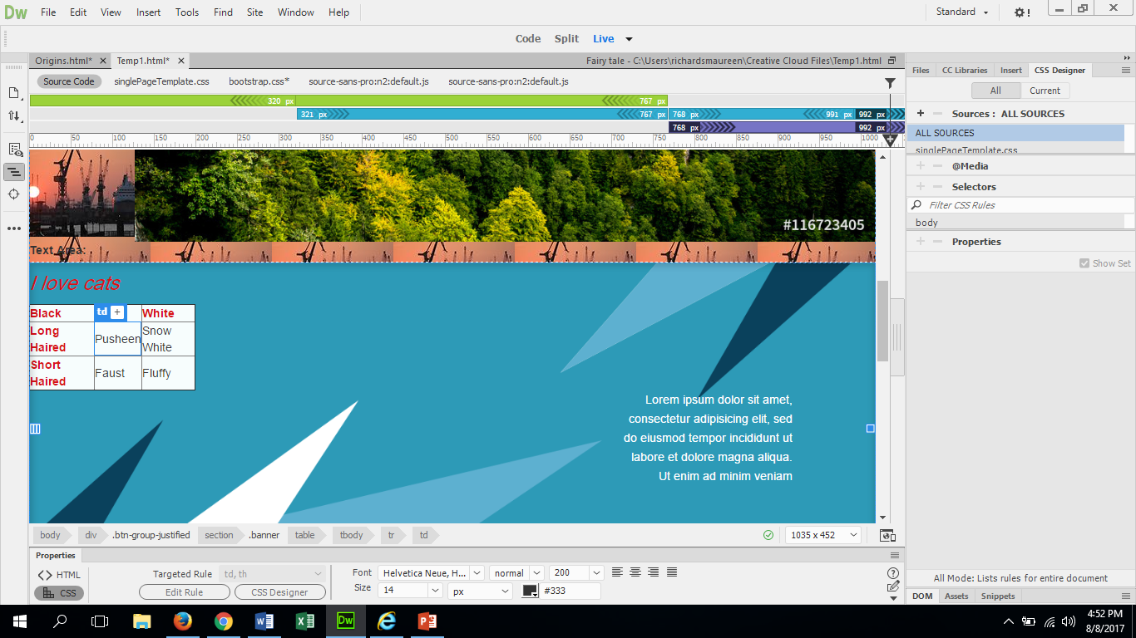
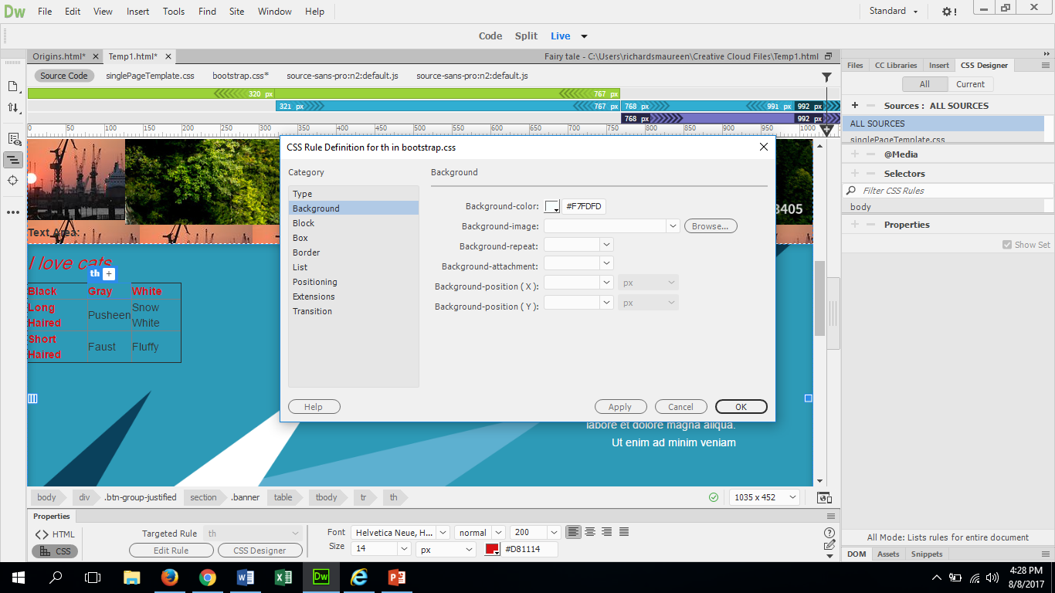
To change the color of the font click the color box and select the color. Once you do that you need to click on the Caption again.
Play with the font and size till you find the one you like
Click on header of the table so that the caption box appears.
All of the font changing and colors and such are all located in the properties bar.
To change the background color of the table you
Click edit Rule in properties
Click Background
Then click the color box on Background-color and then click OK.
Be sure to real-time preview this and save changes made! It would suck to loose all your hard work!!

Slide 4
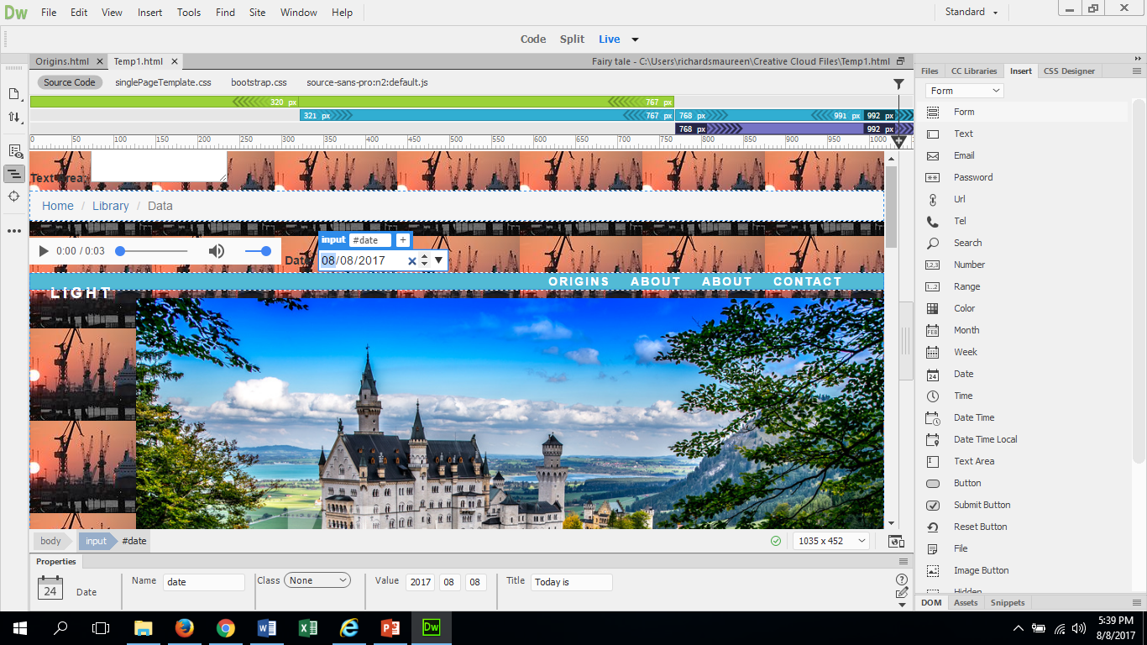
How to insert a date on your website
Place the cursor where you want the date
Go to insert panel and change the HTML bar to FORM
Then Select DATE option
Then in the priorities bar where it says VALUE change the date. Yyyy=year, mm=month, dd=day
Lastly view it in Real-time preview

Slide 5
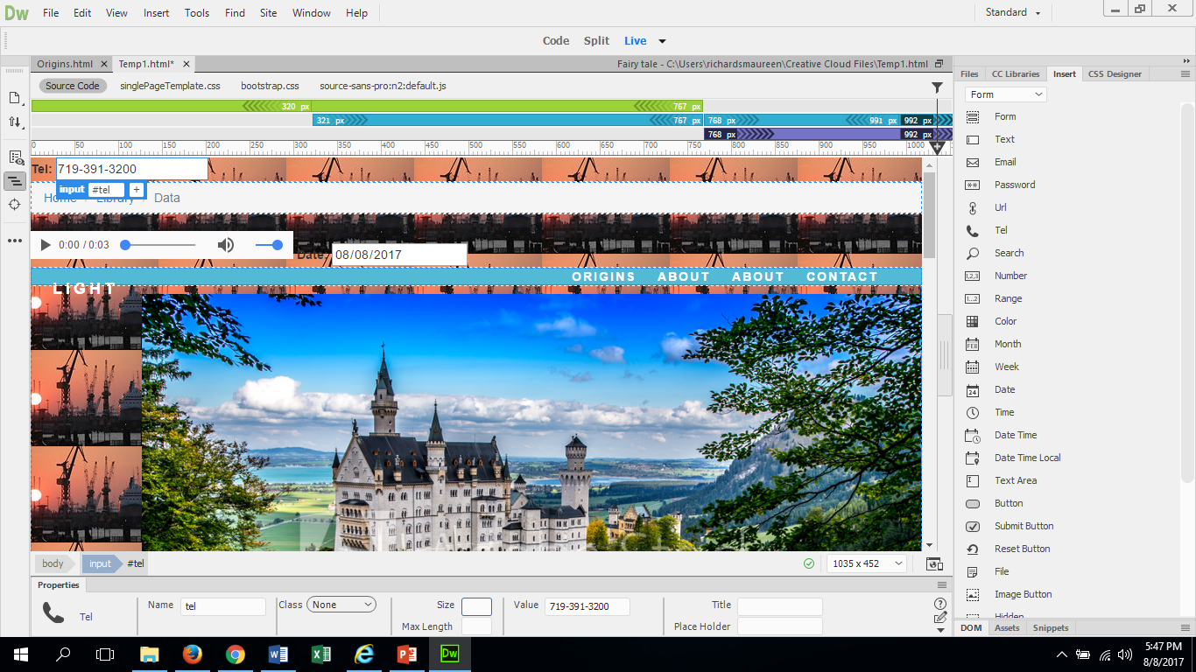
Inserting a Telephone Number and Email
Inserting a Telephone number and Email are very similar to entering a date
Place your cursor where you want it
Open up insert bar and change to form
Select TEL or EMAIL
Then on properties bar change the VALUE

