Slide 1
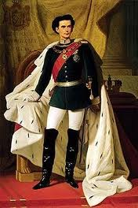
The Fairytale King: König Ludwig II. von Bayern

Slide 2
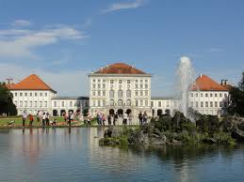
Seine Biografie
Born on 25th August 1845 in Schloss Nymphenburg
King of Bavaria 1864–1886
Died on 13th June 1886 in Lake Starnberg

Slide 3
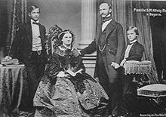
Seine Familie
Vater: Maximilian II of Bavaria (Prinz)
Mutter: Princessin Marie of Prussia.
Bruder: Otto (suffered from a mental illness)
Kusine: Duchess Elisabeth (sissi) von Bayern, later Empress of Austria

Slide 4
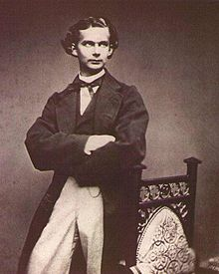
Neuer König von Bayern
18 Jahre alt when his Vater died of an illness in 1864.
He was not ready to be a king, but his youth and good looks made him popular in Bavaria.
He became a patron of
Richard Wagner in 1864 and
Financed/supported many of his
Operas.
Between 1872 and 1885, the King
had 209 private performances : cost
of 97,300 marks
Many of Wagner’s romantic themed
Operas became the inspiration for some
Of his most famous castles

Slide 5
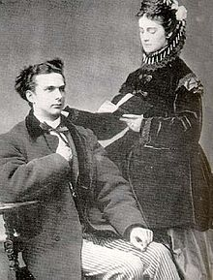
Marriage, or lack there of
22 January 1867 he was engaged to Duchess Sophie Charlotte in Bavaria, but after repeatedly postponing the wedding date, Ludwig finally cancelled the engagement in October.
Ludwig had a succession of close friendships with men, which marked
the king as a homosexual.

Slide 6
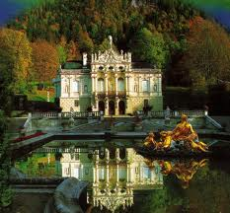
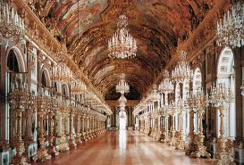
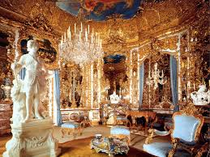
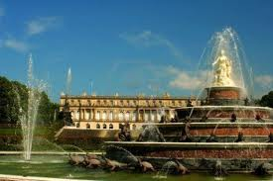
Herrenchiemsee
Schloss Linderhof

Slide 7
Neuschwanstein
Cost: 6,180,047 marks

Slide 8
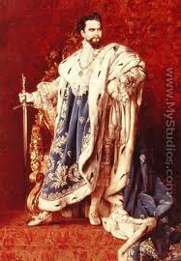
Deposition
Um 4 (Morgenfrüh) 10. Juni. 1886
Government commission arrived at Neuschwanstein to formally deliver the document of deposition to the king and place him in custody
Ludwig was tipped off an 1-2hrs earlier by a faithful servant and ordered the local police to protect him. The commissioners were turned back at the castle gate at gun-point.
That same day, the government publicly proclaimed Luitpold as Prince Regent. The king’s friends and allies urged him to flee, or to show himself in Munich and thus regain the support of the people.

Slide 9
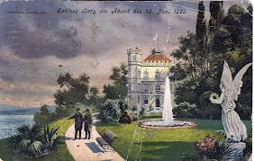
Eventually the king decided to escape
Morgenfrüh am 12. Juni
The King was taken into custody.
Ludwig was transported to Castle Berg on the shores of Lake Starnberg, south of Munich.

Slide 10
Geheimnises Tod
13 Juni .1886, um 6 Uhr abends: Ludwig asked the psycologist watching him, Gudden, to go for a walk.
They were last seen at about 6:30 p.m.; they were due back at 8 but never returned.
The officials searched for 3 hours by the entire castle and at 11:30 p.m.that night
the bodies of both the King and von Gudden were found, head and shoulders above the shallow water near the shore. The King's watch had stopped at 6:54. Gendarmes patrolling the park had heard and seen nothing.

Slide 11
