Slide 1
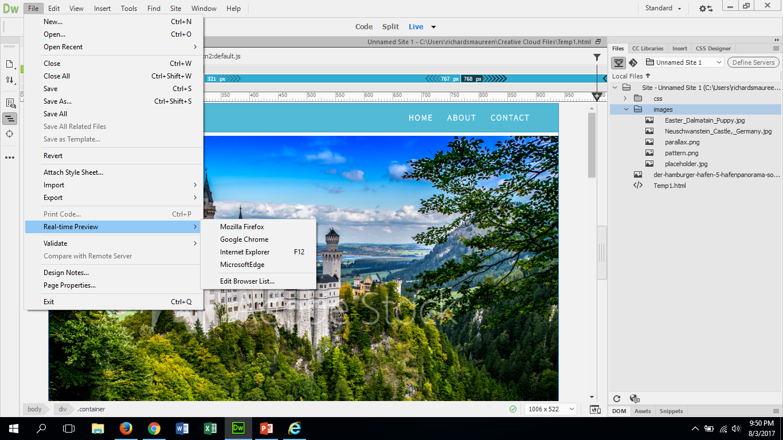
To view your master work in a browser you do this:
You do this to check your work. See how your work looks differently in the different browsers. This is an important step to make sure that it is working correctly.

Slide 2
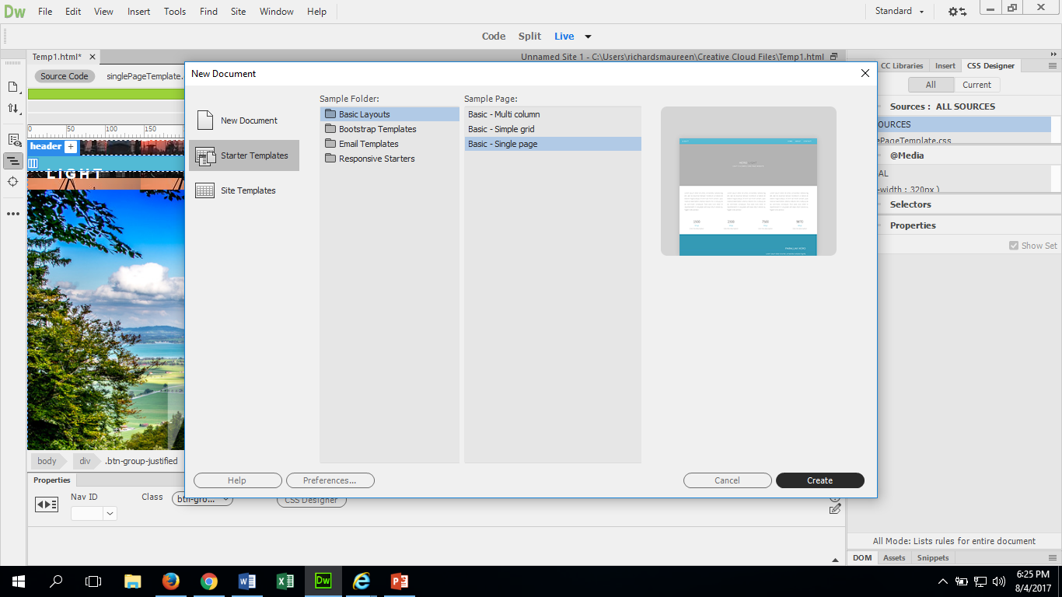
How to create a new page for your site
Click on file at top of current page and click new. A new text box will appear.
Select starter templates, then basic layouts, then I chose single page. Click ok.
Design it like you did the ones before it. Be sure to save the new pages in the same folder in the W:Drive as the home/index page. You want to label each page differently, so that you do not loose any of your work.

Slide 3
Setting up a Navigation bar for access to your different pages
You will need to do a little bit of coding here! Please pay attention. Each one of your websites will have 5 pages and will need to link to each one through out.
You will need to do this step last, because you will need to have all of the individual pages saved in your designated folder.
Open up the page that you want your “home” page to navigate to. It will look like this…2 pages open:

Slide 4
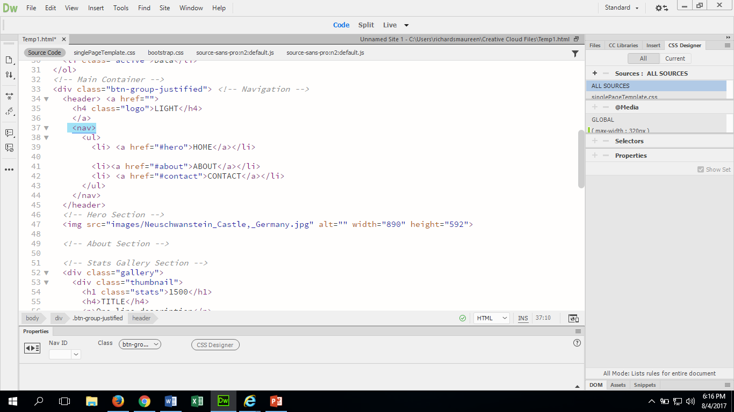
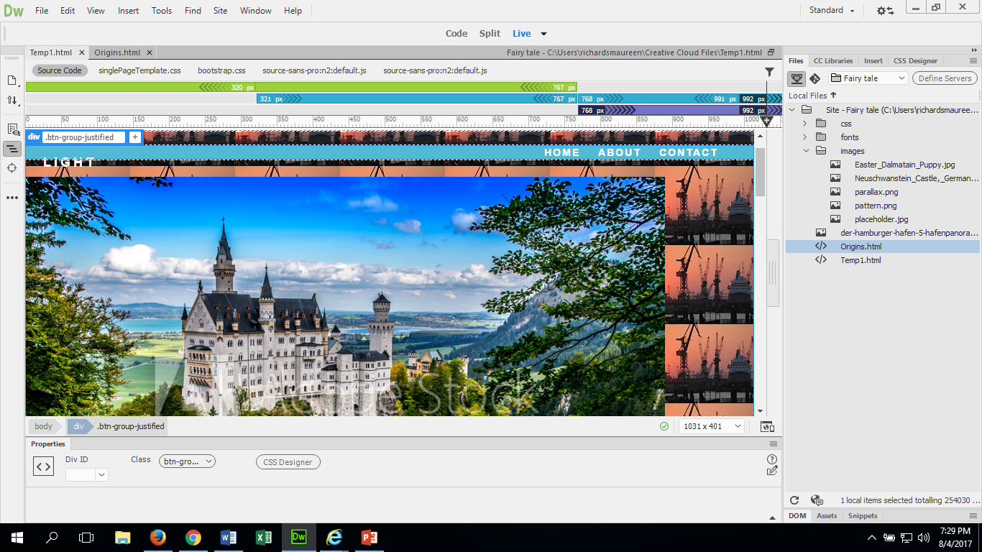
Navigation Continued:
On our main page you need to find the name of the document that you are going to be connecting to it. You can find the name (in case you have forgotten) here
You will need to switch to “code” mode. You will need to look for the <nav> within the coding. This is where the navigation bar is set up. It will look like this :
The # Hero is where the document name will go. Mine is Origins.html
The >Home< Should be changed to the name of the page it will be. Mine will be Origins
This is where your tabs at the top of the page for navigation are

Slide 5
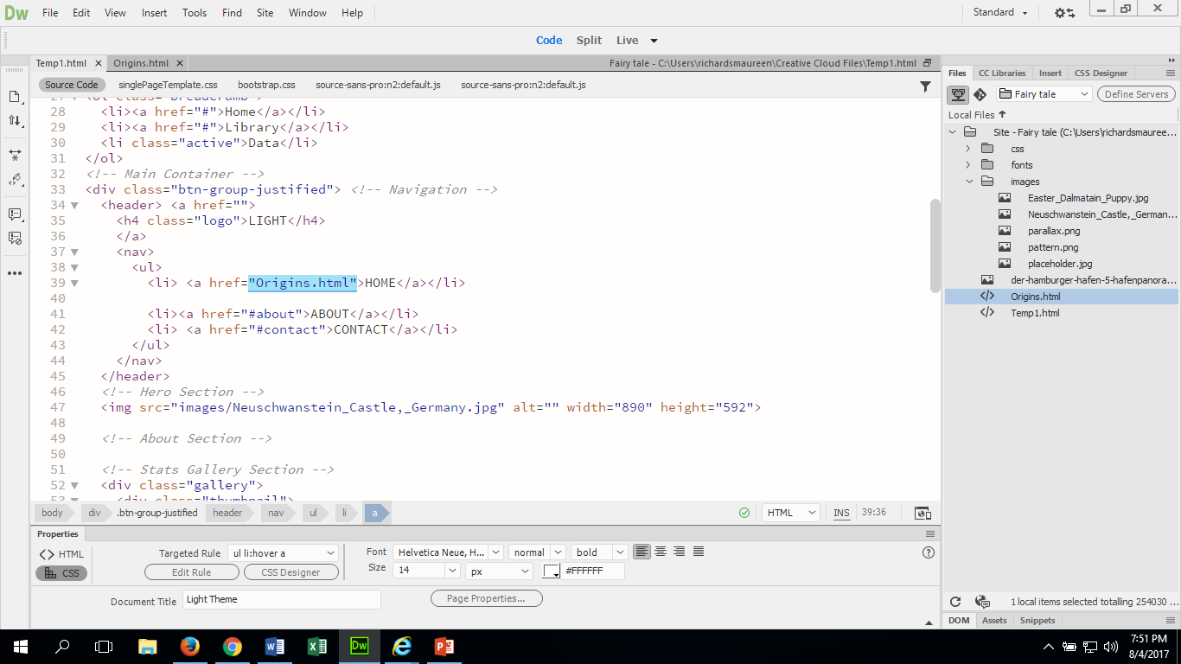
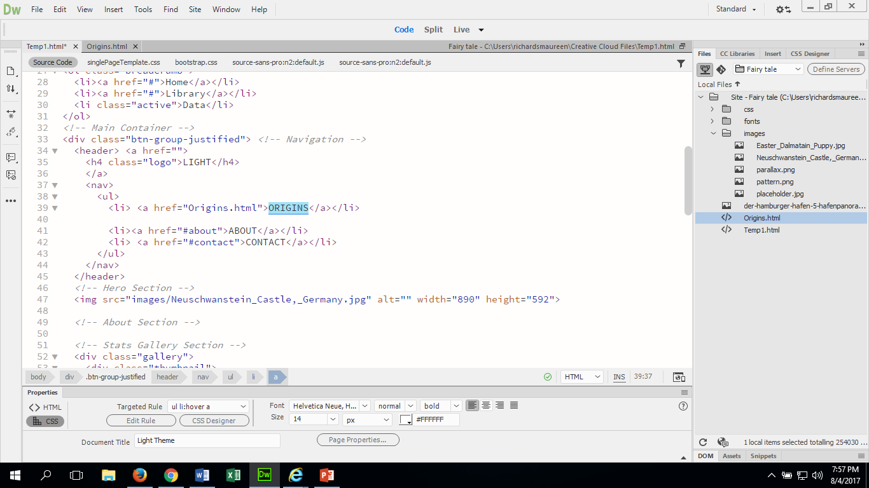
Navigation continued:
Between the two quotation marks “ “ I will change the word hero to the name of my connecting page “Origins.html” and you get rid of the #. All this does is allows my page to connect through.
Next I need to change my >Home< to the title of my page. I am calling it Origins. This will rename my button.

Slide 6
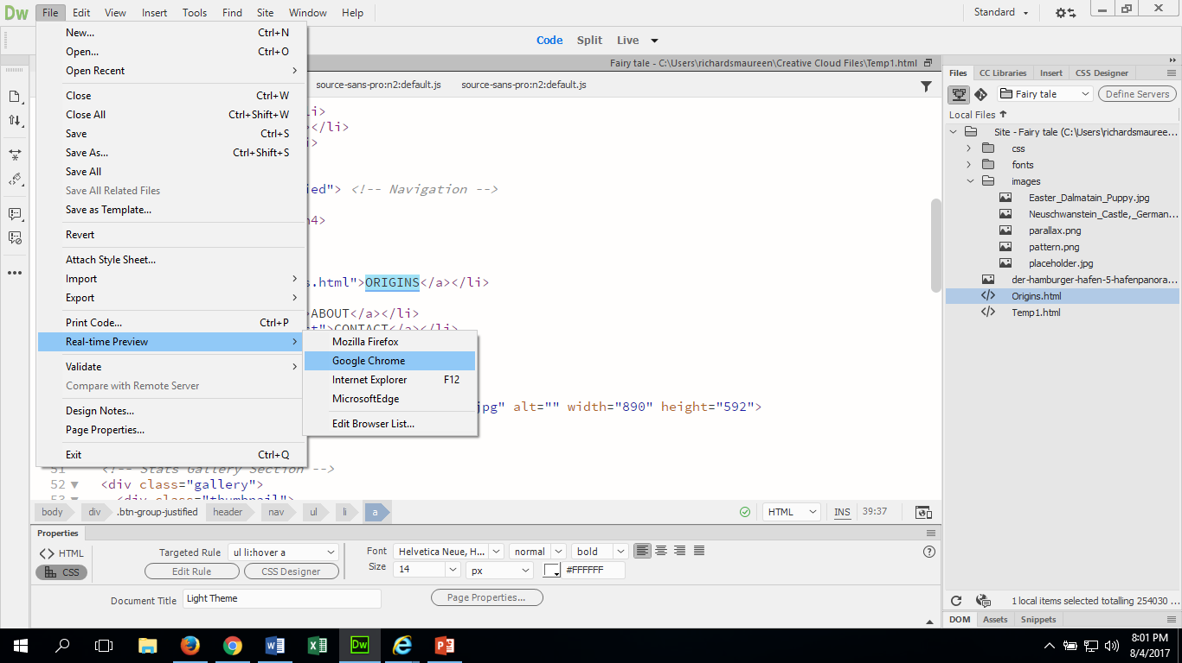
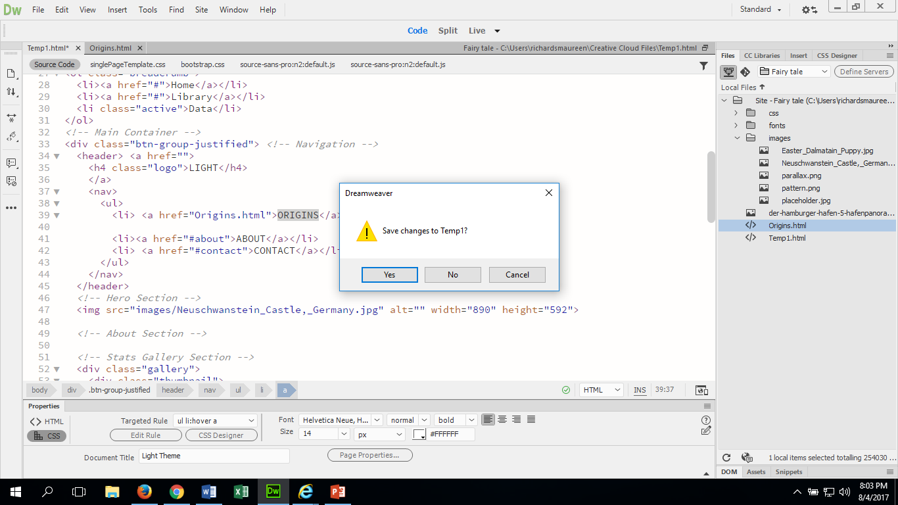
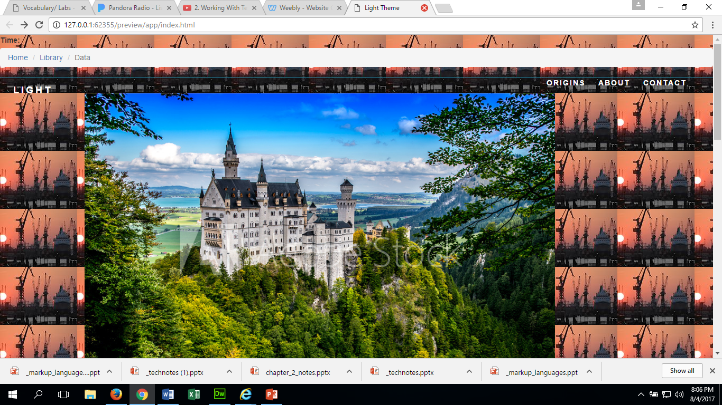
Check your navigation:
Go to File and click on Real-time preview and select your browser.
A dialog box will open wanting to save your work. Click YES! This is very important so you don’t loose your work!
Open your browser. You should see the name of the next paged labeled what you called it and if you click it, it should open your next page

Slide 7
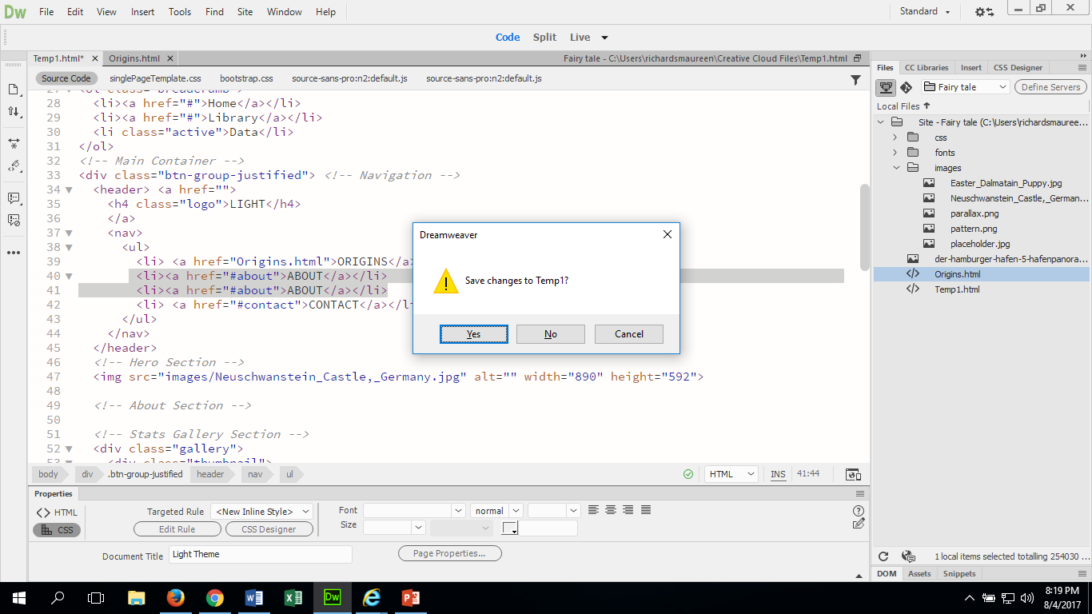
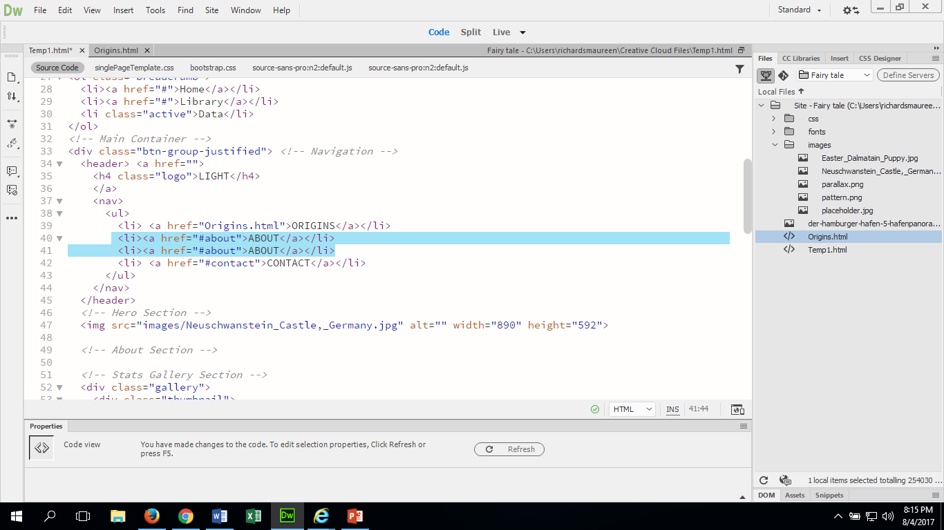
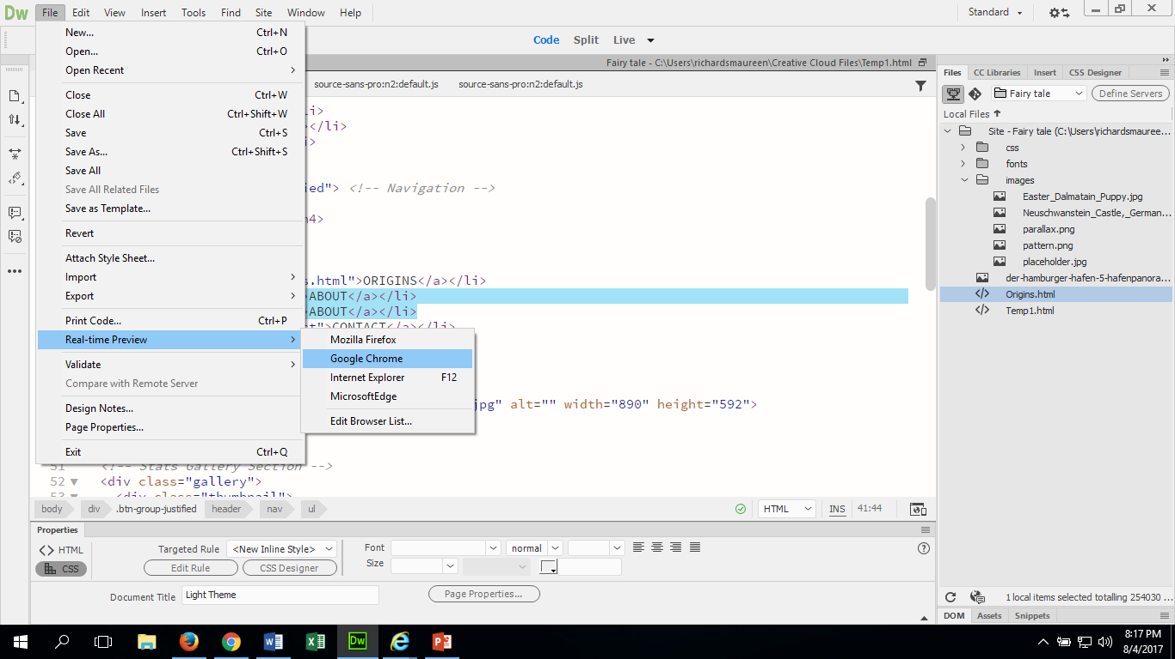
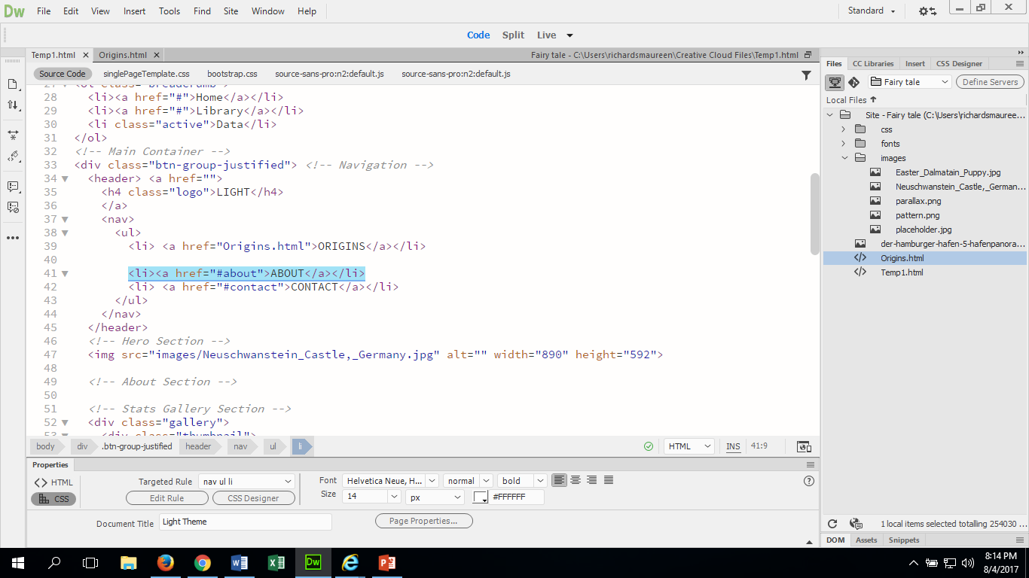
To create more buttons for your navigation to other pages:
Go to code view and copy one of the link code information. Be sure to select one that is not linked. It is to serve only as a place holder until you are ready for it.
Preview it in browser
Click Yes to save
Paste the copied information below the other ones. It should look like mine
Check your browser to make sure that it shows another button at the top. It will be labeled like another one. That is ok, because you will change it when you are ready

Slide 8
This is how websites end up on the internet
Do to protecting your information online, your website will not actually be published on the internet. Due to this, if you would like to show your parents what you have done, then you will need to screen shot your work and email it to them.

