Slide 1
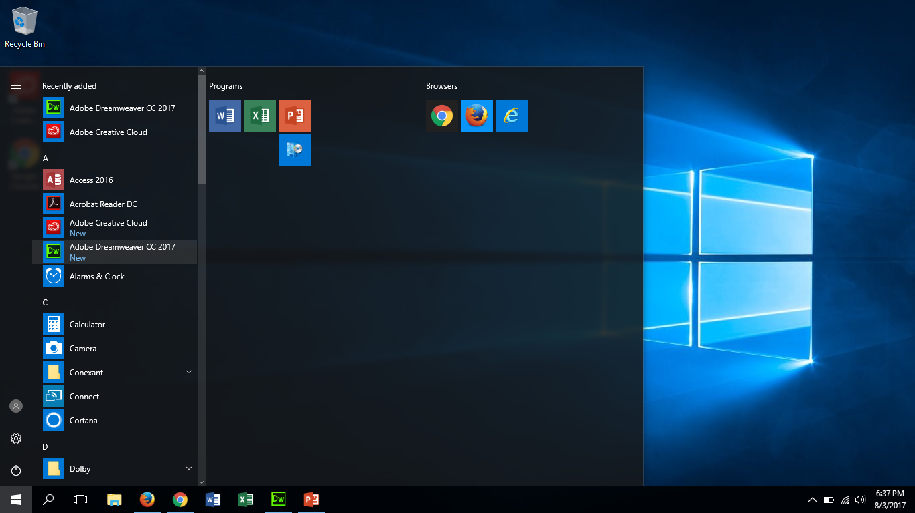
Click on Adobe dreamweaver
To open the program. It might take it a minute for it to load.

Slide 2
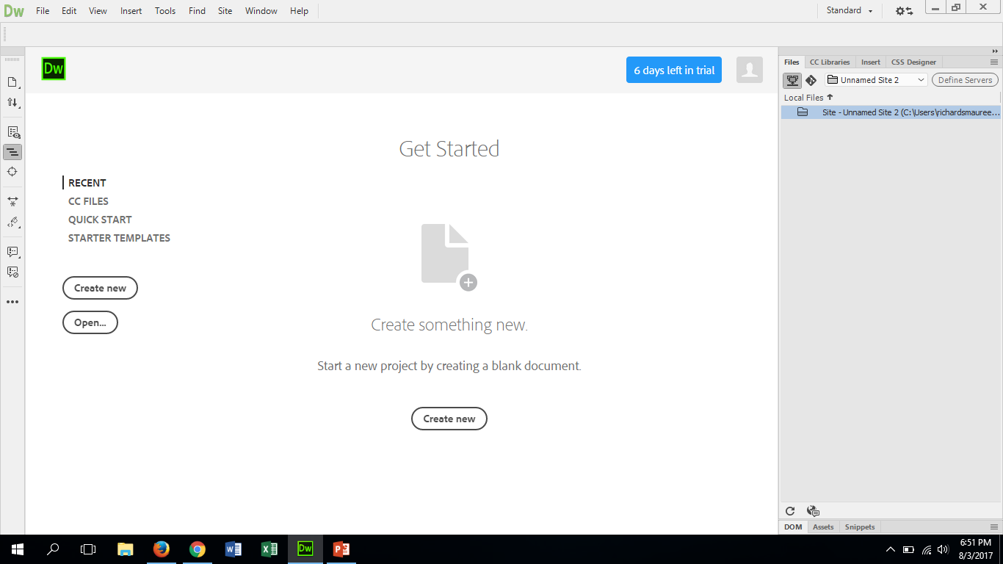
Select Starter Templates
Choose from the selection that works best for your website needs. NEVER SELECT BLANK/CREATE NEW! You will need to the templates areas provided to stylize your cite.

Slide 3
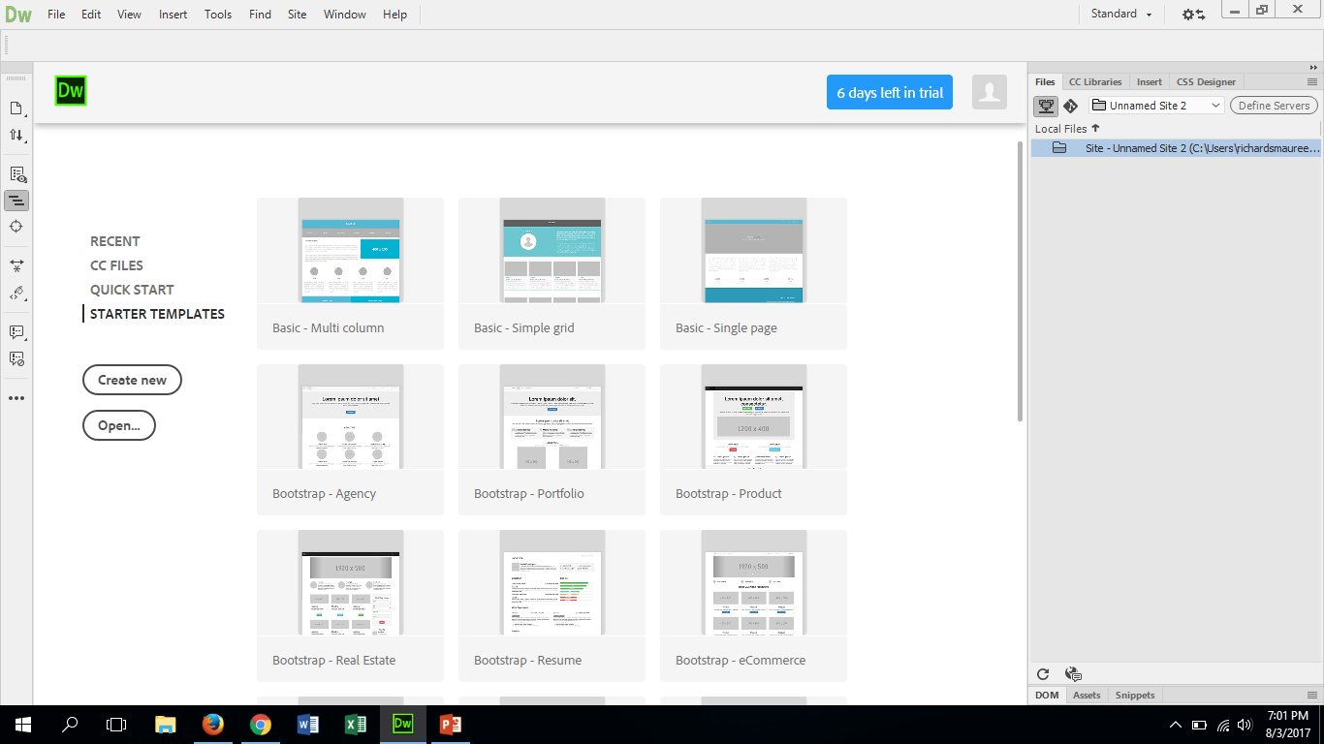
Your Options look like this:
You may need to open them up to choose which you like best!

Slide 4
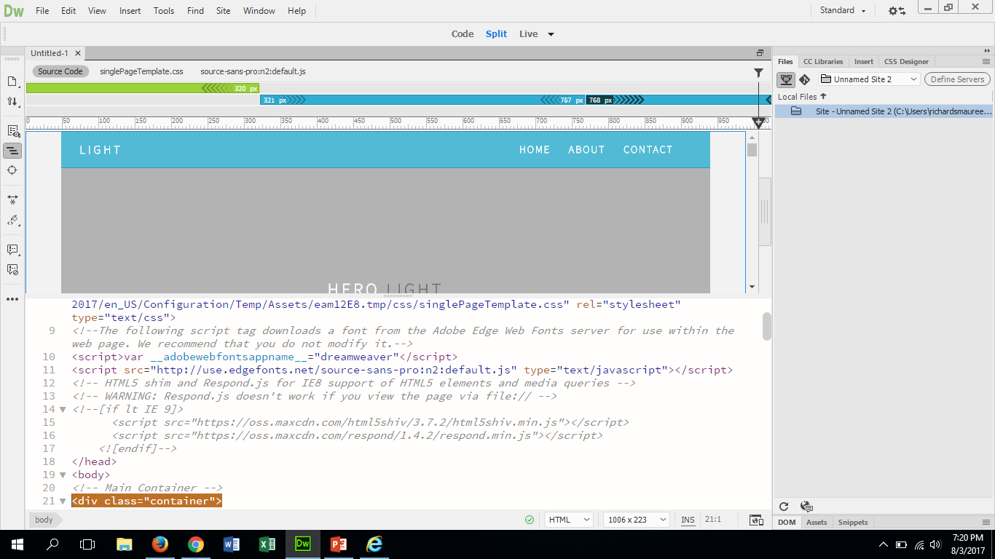
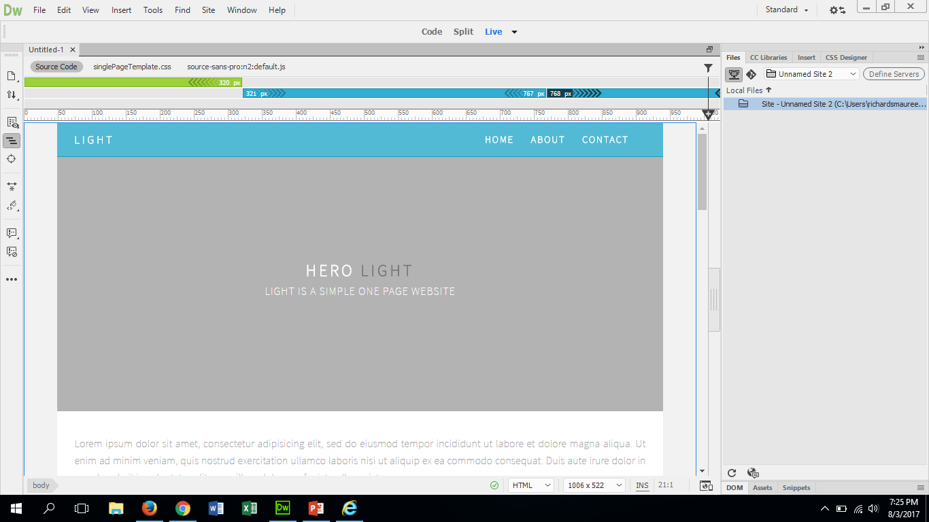
Your template will always show you the coding
Unless you already feel comfortable with coding, you can actually drag the view bar to fill the whole screen. It is located here. Just drag downward to hide coding. Or you can select the top view to what you want to see.
It will look like this

Slide 5
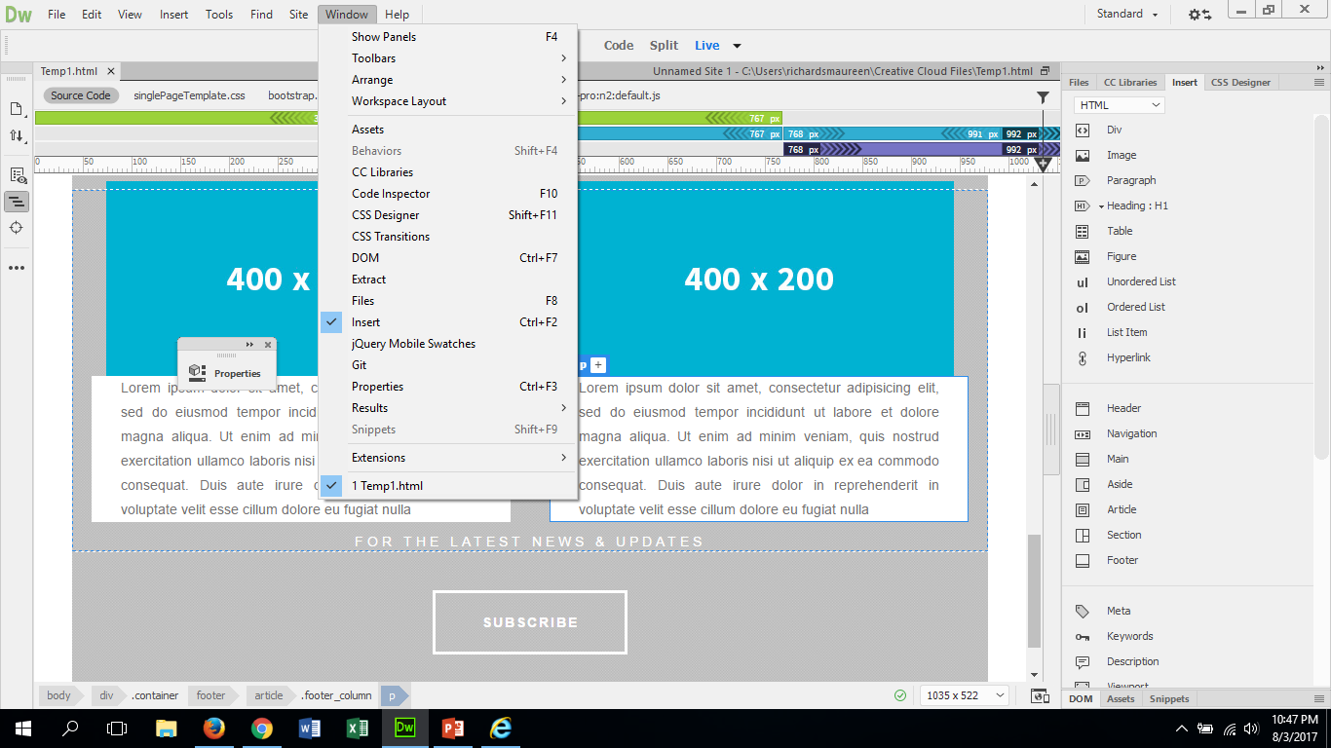
To Change Colors and Fonts of your cite
You need to make sure your cursor is where you want the changes to happen.
You will also need the properties bar…You can find this at the top of your page under Window toward the end of the list. It will look like the little box next to it when open

Slide 6
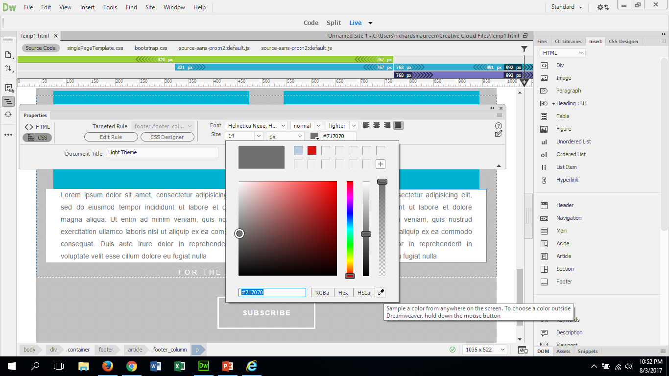
Changing colors and Fonts cont.
Once you have the properties bar you can change the colors of the text. You can choose the color you want or you can use the eye dropper to pick up a color in the pictures to use. Also here you can change the size and the style of the font.

Slide 7
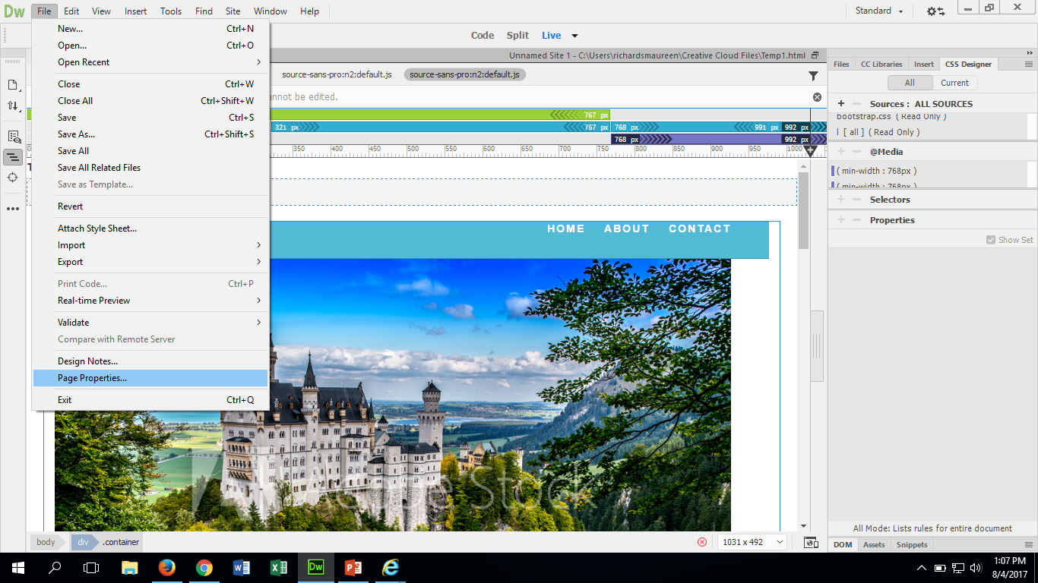
To insert an image or to change background color of page:
Click on FILE then select PAGE PROPERTTIES…a dialog box will show up with options for you to choose. ONLY CHANGE THE STUFF LABLED CSS AND NOT HTML… these two do not communicate with each other and can cause an image to “break”
In order to set a background image, be sure to have the image already saved in the file you’ve already created in the W:drive for the website. The file should be in JPEG.
If the image file is too small, it will duplicate it in the background. We will learn later how to enlarge the image back there to fill the entire space.

Slide 8
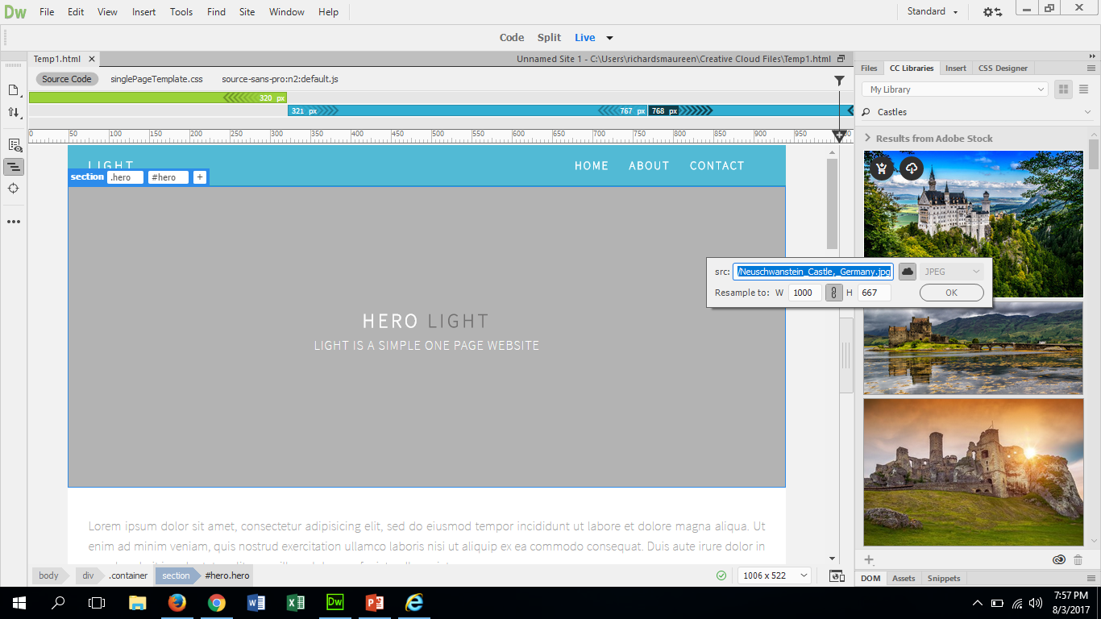
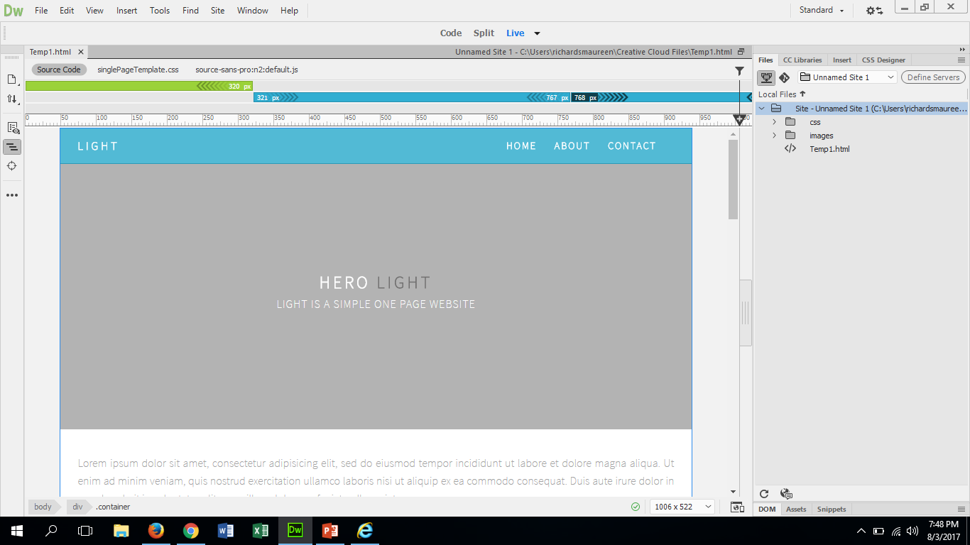
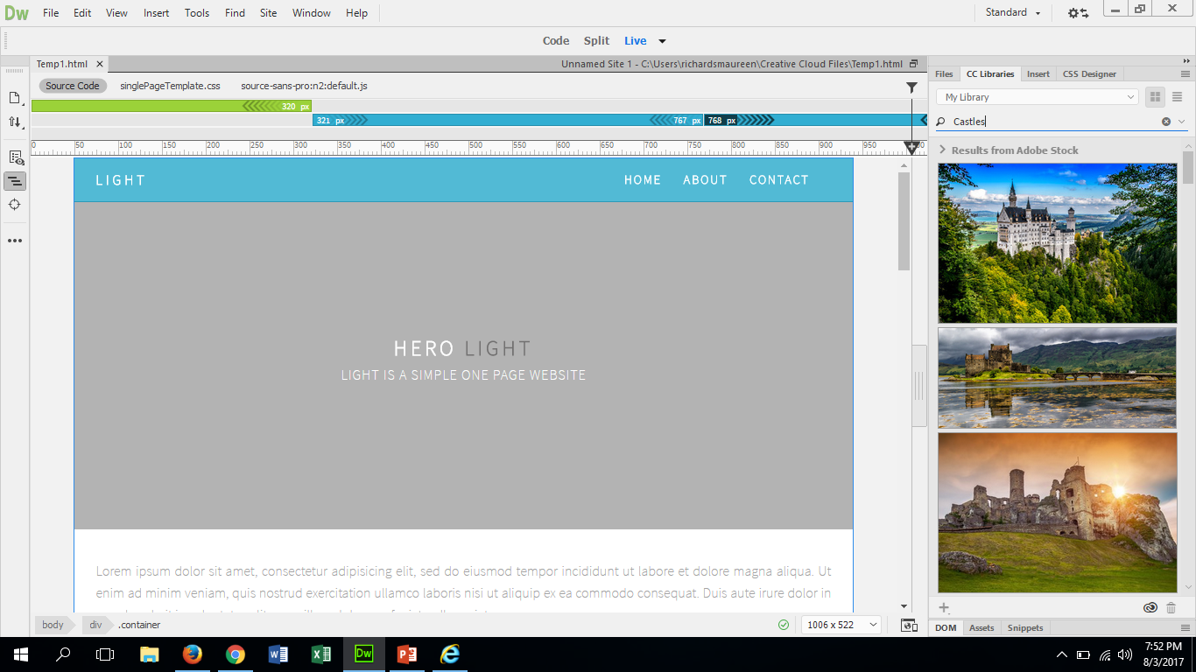
Photo insert there are two ways to do this
To use the stock photos that are provided by Adobe, click on Cc Libraries located to the right.
This Text box will show up. Make sure that it is saving in your W: Drive under the correct folder. All of the pieces must be located in the same folder!!!!
Then Click OK.
Type in the search bar what you are looking for.
Then choose an image and grab it with the cursor and slide it where you want it.

Slide 9
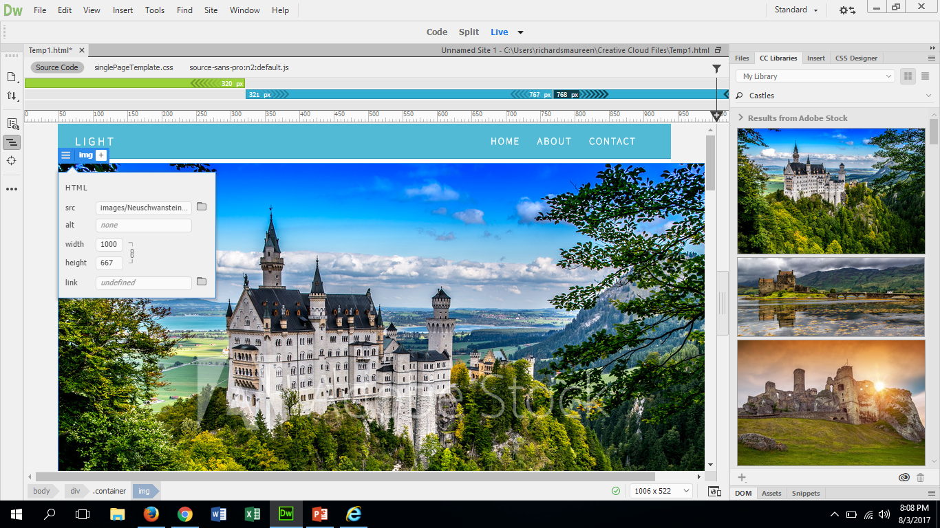
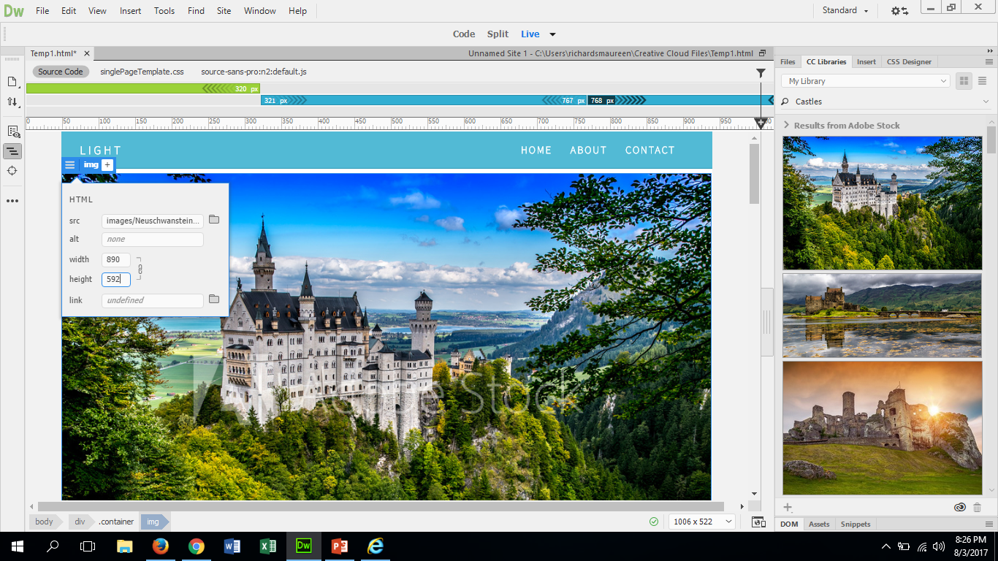
To change the size of the image
Click on the dash marks and then change the number in the height. You will have to play with this until you get the size that you want. It will automatically adjust the width of the image to it’s height.

Slide 10
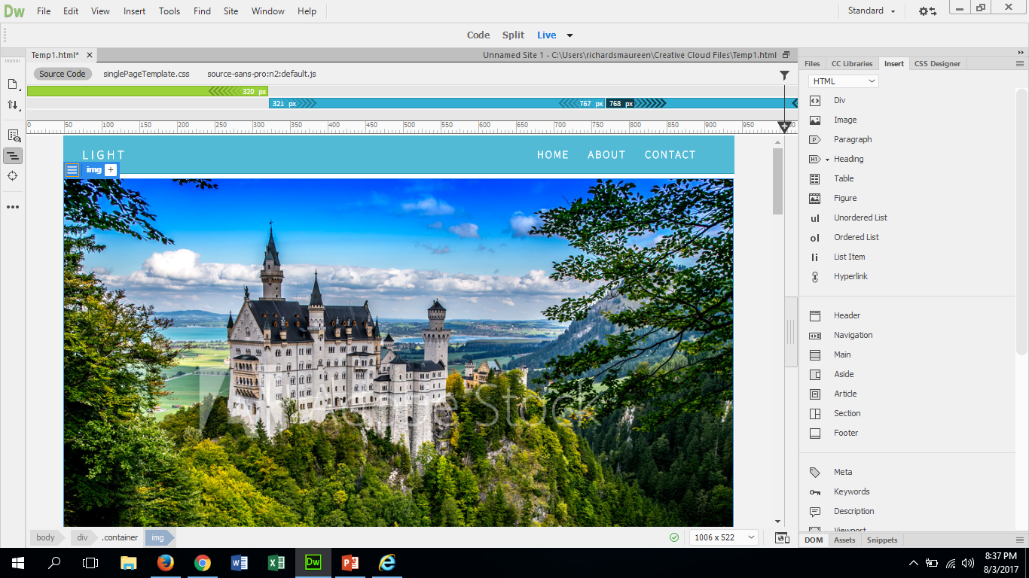
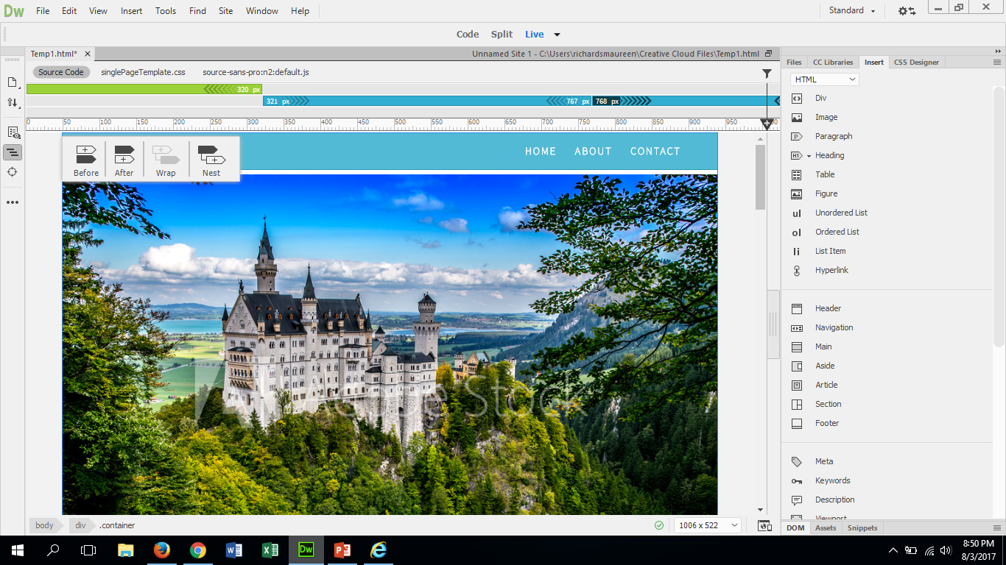
Second way to insert images into website
Make sure to save photo into folder with other documents for site on the W:Drive
Using the Insert Bar on the right select insert image and follow the steps suggested
move where wanted and go from there
BE SURE TO SAVE WHEN ASKED, OR YOU WILL LOOSE WHAT YOU JUST DID

