Slide 1
Welcome To Introduction To Web Design
Teacher: Ms. Richards
Office: 129 (German Room)

Slide 2
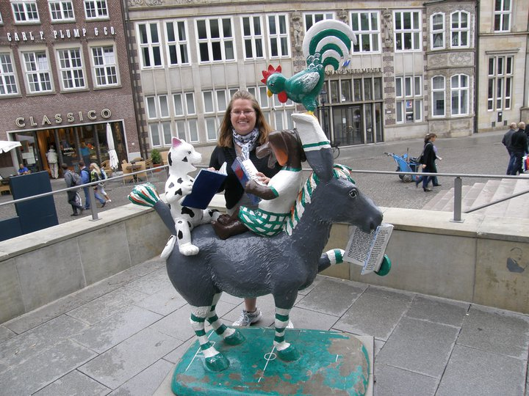
Ms. Richards ( Frau)
“Why worry? If you’ve done the very best you can, worrying won’t make it any better.”~Walt Disney

Slide 3
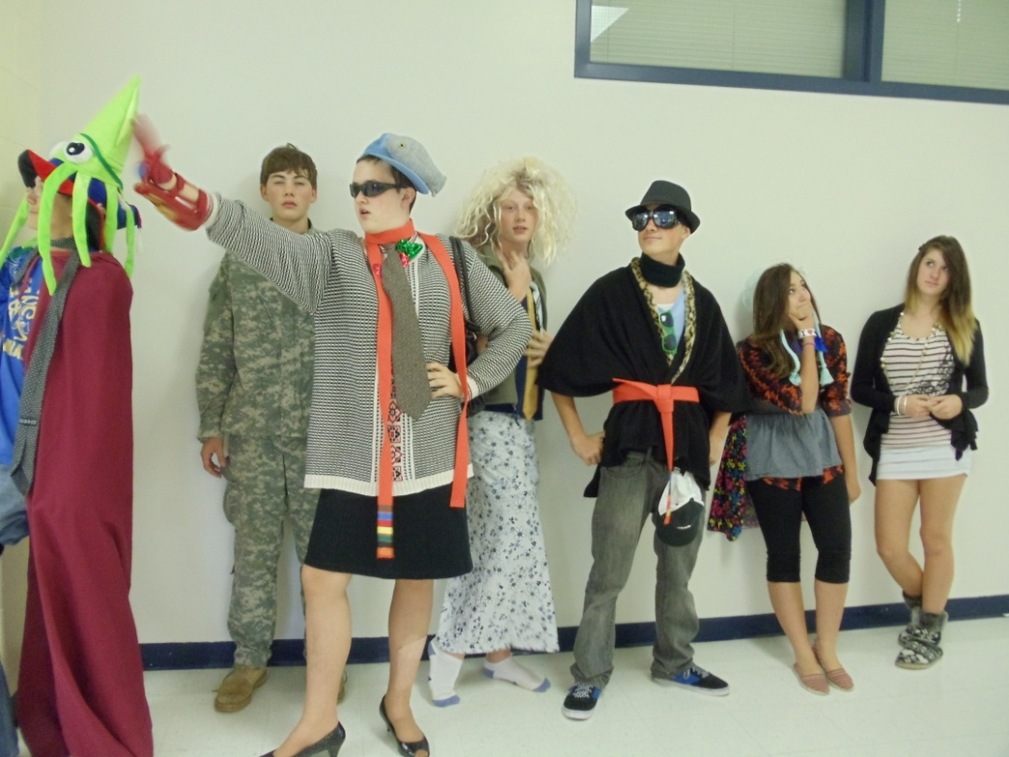
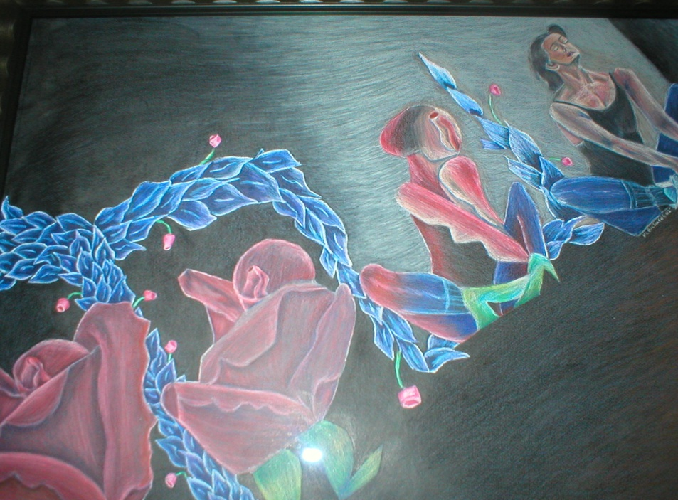
School and such
I studied at UNC and CU.
I have taught for 4 years!
My favorite classes in high school were German and Art!

Slide 4
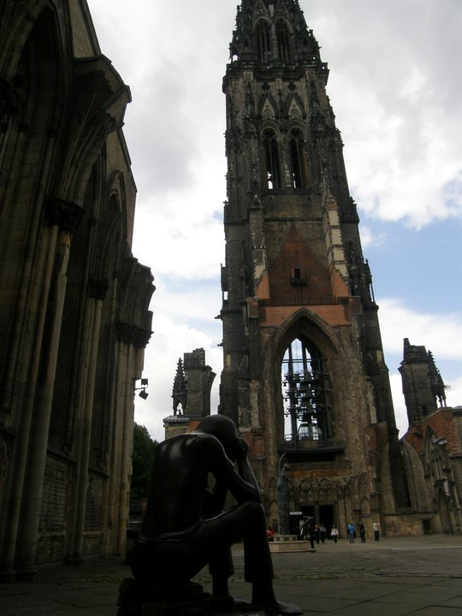
Fun and Hobbies
I am a traveling bug!
In high School, I used to ride horses competitively

Slide 5
Faust
Yep it is true! I am the crazy cat lady that your mom warned you about!

Slide 6
First lab (in class assignment)
Goal is to create the coolest PowerPoint in class to win a prize:
Must have at least one picture of you
Include a favorite quote
Include favorite class(es), activities that you do for school
Hobbies/ what you do for fun(Other than homework ;) )
Family/pets/best friends ( who/whatever is special in your life)
Minimum of 4 slides
*You can use pictures/animation/music whatever you want in your PowerPoint as long as it is school appropriate!
Be creative and have fun with it! Show me what you can already do!
And let the games begin and may the odds ever be in your favor!

Slide 7
y
Illegal downloading sites for music, videos and games
ICR and Web-based chat
Technologies Influences on Society
Computer
Facebook
GoToMeeting
Cell Phone/ Smart Phone
USB Drive
Xbox 360
IPod/ MP3 Player
Ones I’ve Used
Printers/copiers
Internet
Skype
Ones I’ve heard about
IPad/Tablets
IM Chat
Twitter
Digital
Camera
Flat Screen TVs
Email
YouTube
3D virtual worlds
Netflixs
Wikipedia
Blogs/video blogs
GoPro Camera

Slide 8
Facebook/LinkedIn/Classmates: Social networking sites and allows members to share movies, pictures and many other media forms by use of Tags
Xbox 360: Massively Multiplayer Online Games are ones that allow the players to play online against opponents from around the world (Call of Duty)
Blogs: are online journals or diarys to share ideas or opinions.
video blogs: are like YouTube and allows users to post videos and comment on other videos.
Internet Relay Chat (IRC)/ IM: Venue where people with common interests can exchange text/multimedia messages in real time.
Collaborative Workspace/ Virtual Meeting Spaces/ GoToMeeting: Allows professionals, business partners or employees to communicate with each other using text, audio, video, whiteboard and shared files without leaving their desks.

Slide 9
Network-Computers, printers and data file storage devices connected together to enable sharing of computing resources and data.
What are some examples of a network?
Internet: A world wide public network that connects millions of public networks.
Web Servers: Store specifically formatted electronic documents called websites

Slide 10
Web pages: can contain images, text, interactive elements and
hyperlinks: link other pages to other ones
Website: is a group of related pages and the main page in the collection in called a Homepage
http://fraursdeutschseite.weebly.com/
Level 3 (internet’s backbone) = is located in Broomfield, CO.
It connects West and East Coast. It is manned 24/7 to keep the internet functioning.
http://maps.level3.com/default/#.Urz5hK4nOa8

Slide 11
Smartphone: Wireless phone that can access internet, calendar, camera, etc.
Personal digital assistant (PDA)- handheld computer used to manage personal information and access the internet.
Personal Website: designed to have employment information, meet new friends or to connect with people who have the same interest as you.
NEVER SHARE PERSONAL INFORMATION ON THESE SITES!!!
Organizational Website: designed to reach out to an organization’s members for support and participation.
American Kennel Club
Topical Website: based on a topic (anime for example)
Commercial Website: promote and sell products or services (Walmart.com)
Search Engine: Web-based search tool used to locate web pages using either keywords or phrases.
Metasearch Engine: performs a keyword search using multiple search engines’ indexes. ( Dogpile)
Spiders and Robots: browse the Web looking for new pages to add the new URLs to search engine indexes.

